Slide 1




NSTX-U
Supported by
NSTX Centerstack Fabrication Status
Coll of Wm & Mary
Columbia U
CompX
General Atomics
FIU
INL
Johns Hopkins U
LANL
LLNL
Lodestar
MIT
Lehigh U
Nova Photonics
Old Dominion
ORNL
PPPL
Princeton U
Purdue U
SNL
Think Tank, Inc.
UC Davis
UC Irvine
UCLA
UCSD
U Colorado
U Illinois
U Maryland
U Rochester
U Tennessee
U Tulsa
U Washington
U Wisconsin
X Science LLC
Culham Sci Ctr
York U
Chubu U
Fukui U
Hiroshima U
Hyogo U
Kyoto U
Kyushu U
Kyushu Tokai U
NIFS
Niigata U
U Tokyo
JAEA
Inst for Nucl Res, Kiev
Ioffe Inst
TRINITI
Chonbuk Natl U
NFRI
KAIST
POSTECH
Seoul Natl U
ASIPP
CIEMAT
FOM Inst DIFFER
ENEA, Frascati
CEA, Cadarache
IPP, Jülich
IPP, Garching
ASCR, Czech Rep
James H. Chrzanowski
and the NSTX Upgrade Team
Princeton Plasma Physics Laboratory
NSTX Upgrade Project
Office of Science Review
LSB B318
October 2-3, 2013

Slide 2
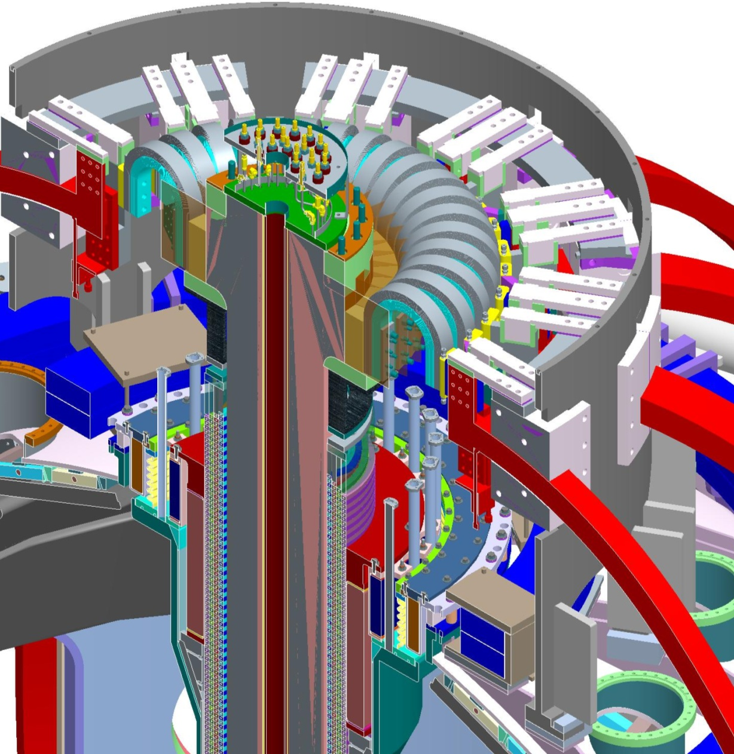
General Arrangement
Umbrella Structure
TF Flex Bus and Support Structure
Centerstack Assembly
Major Centerstack Components
Outer TF Coils
Vacuum Vessel

Slide 3
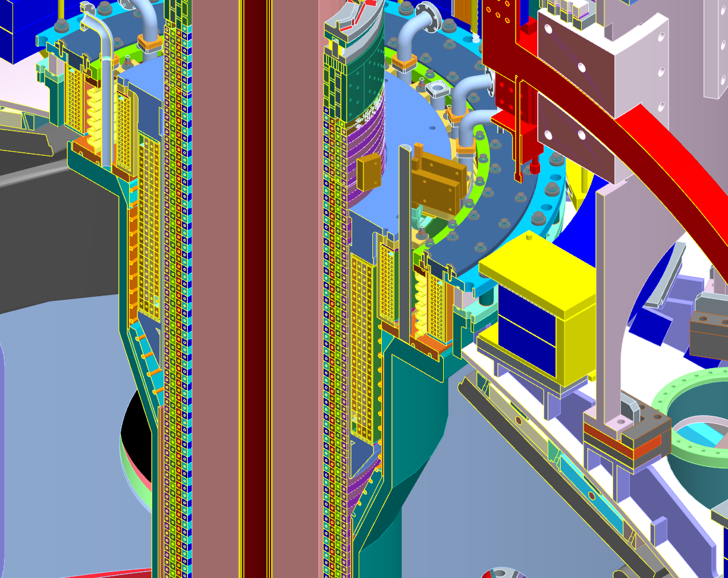
Upgraded Centerstack Components
Ceramic break assembly
Inner PF1c
Inner PF1b
Inner PF1a
Inner TF Bundle
Plasma Facing Components
Ohmic Heating Coil
CS Casing

Slide 4
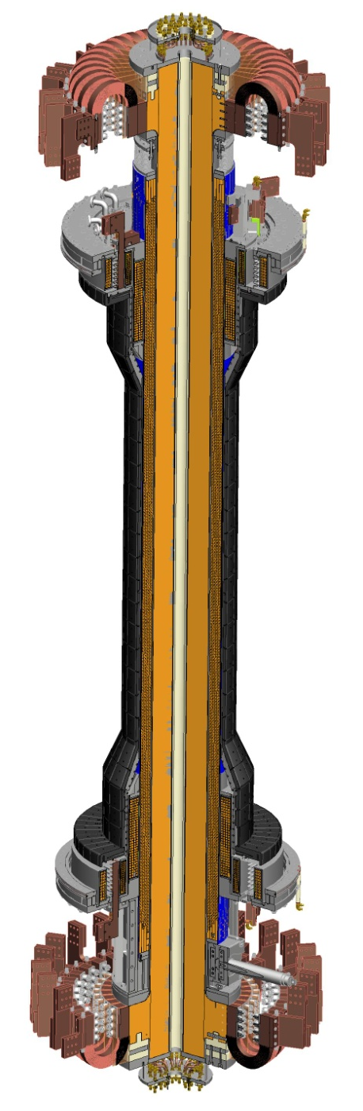
Center Stack Status Since Last Review
Inner TF Bundle
  (4) TF Quadrants have been VPI’d
  Full TF Bundle has been VPI’d
OH Solenoid
  Major tooling has been delivered
  Begin winding OH solenoid- October 2013
  VPI OH Solenoid- January 2014
Centerstack Casing
  Delivered and studs have been installed-
Outer TF Coils
  (2) New TF Coils fabricated
Centerstack Assembly-
  Final CS assembly will occur between February- May 2014
Work was supported by Steve Raftopoulos, Mike Mardenfeld, Irv Zatz & Technician crews led by Mike Anderson and Eugene Kearns

Slide 5
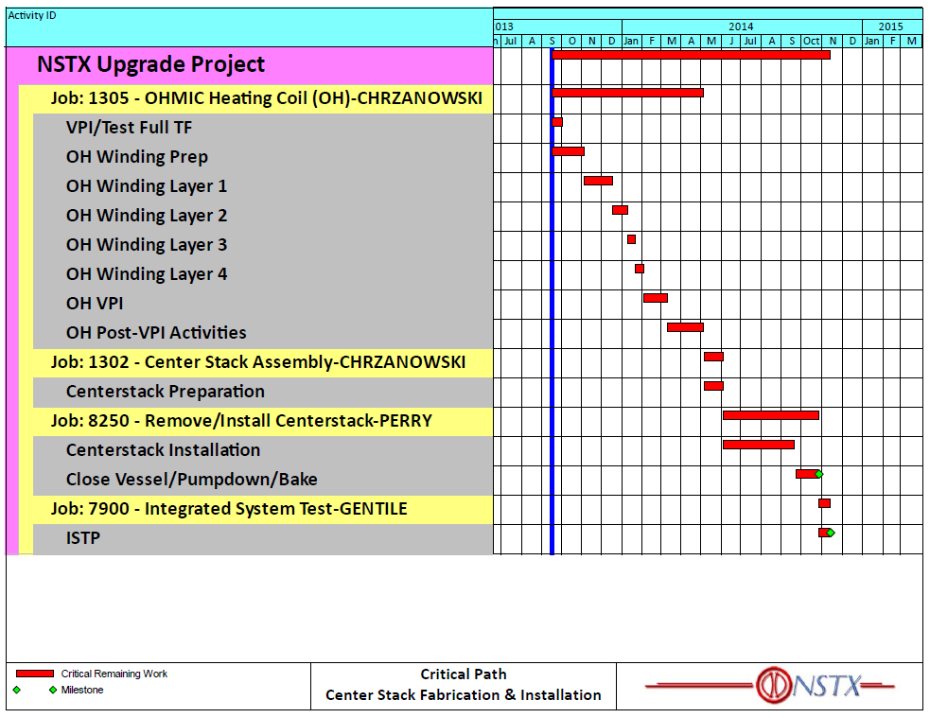
Critical Path Schedule
The OH Manufacturing steps are series activities w/ very few parallel activities

Slide 6
Involvement of ES&H Safety Department
The fabrication & assembly of the Centerstack is being performed by PPPL personnel at the laboratory.
Safety is an important part of the PPPL culture
Safety is incorporated in all aspects of the development program- carryover to production
Industrial Hygiene (IH) & Construction Safety have participated in the planning and setup of the coil area
Job Hazard Analysis (JHA’s) are being developed for each procedure
Procedures: Clearly identify safety precautions for specific operations
Personnel protective equipment (PPE’s) being used
“Tool Box” Safety meeting held monthly with Technicians
Involvement with all safety groups

Slide 7
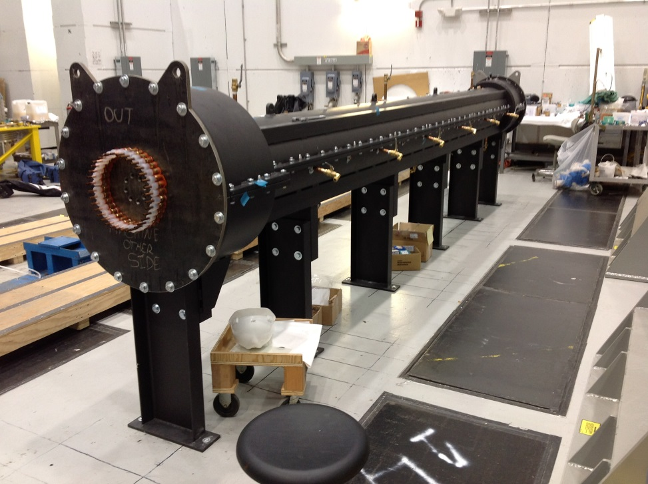
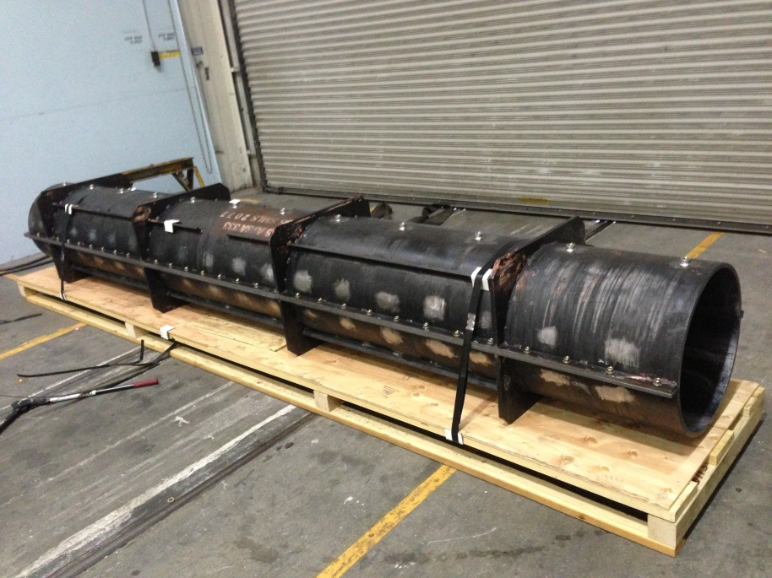
Tooling- VPI Molds
TF Full mold complete-manufactured by Reno Machine (Conn.)
OH Solenoid mold complete- manufactured by Martinez & Turek, Inc. (California)
TF Mold
OH Mold

Slide 8
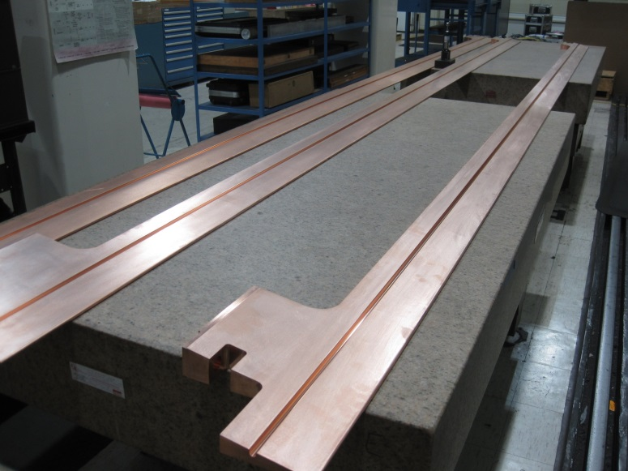
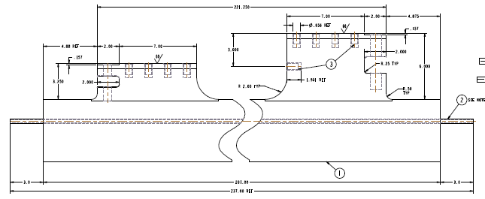
TF Conductor Assembly
Major Tool & Machine Inc. and sub-contractor Edison Welding Institute (EWI) have completed the manufacturing the TF conductor assemblies.
54 conductors have been delivered (6- Quadrants)

Slide 9
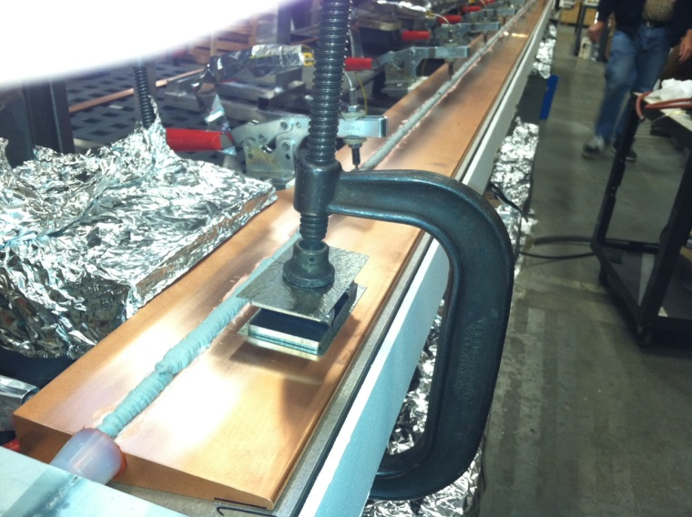
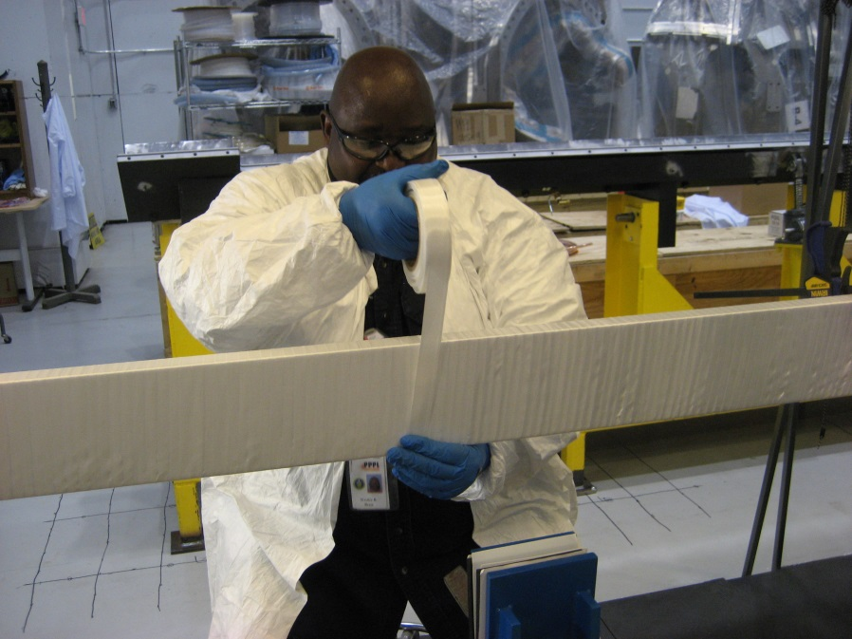
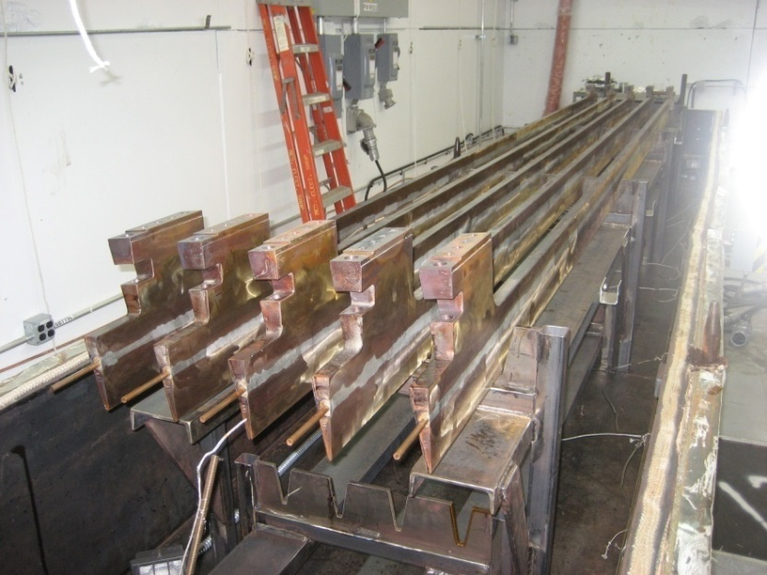
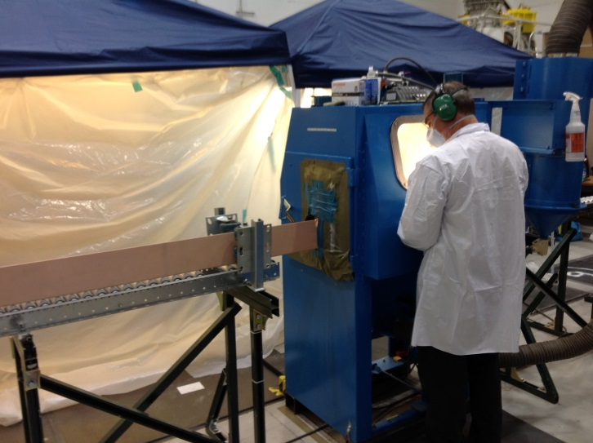
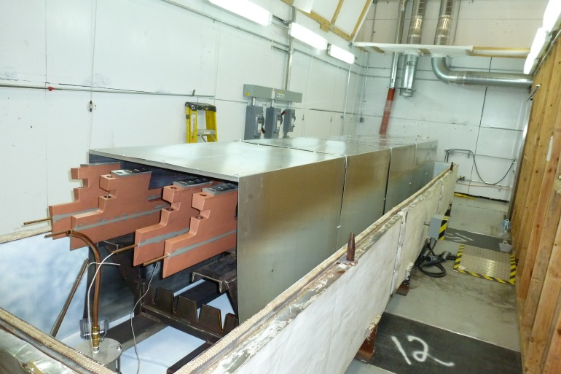
Step 1- Fabrication of Inner TF Bundle
Solder Cooling Tube
Apply turn insulation by hand
Post Solder Bake
Grit blast conductors
Prime & Cure

Slide 10
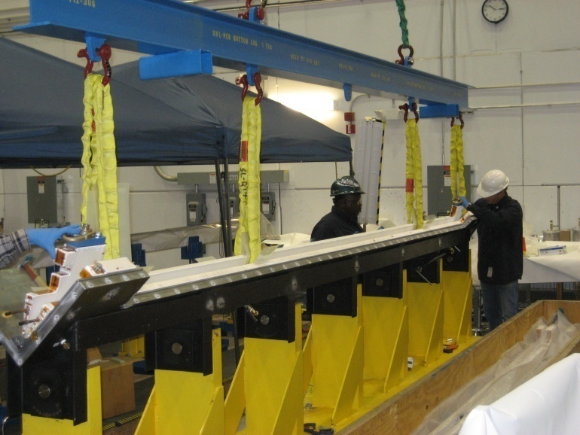
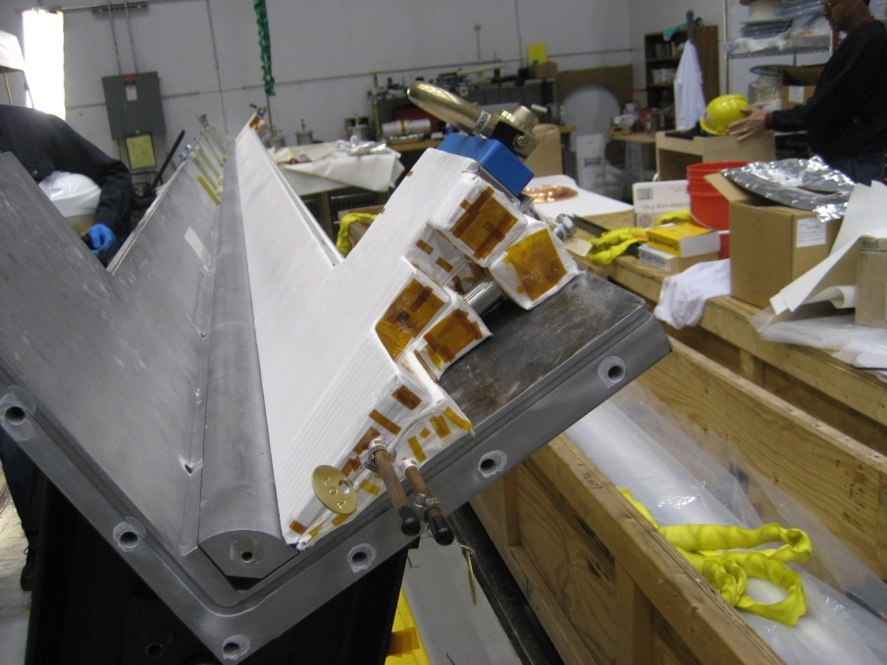
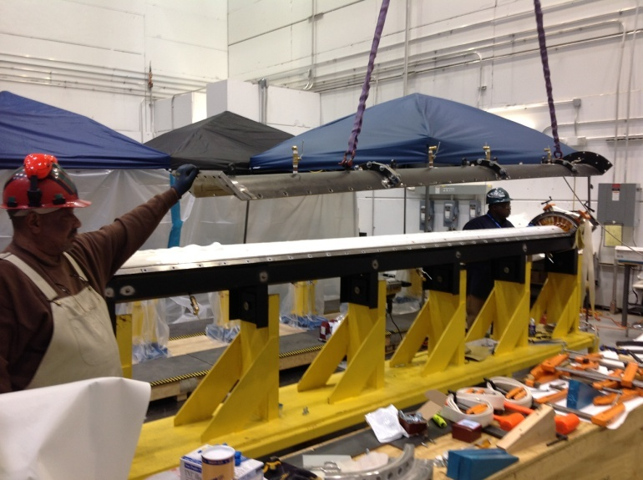
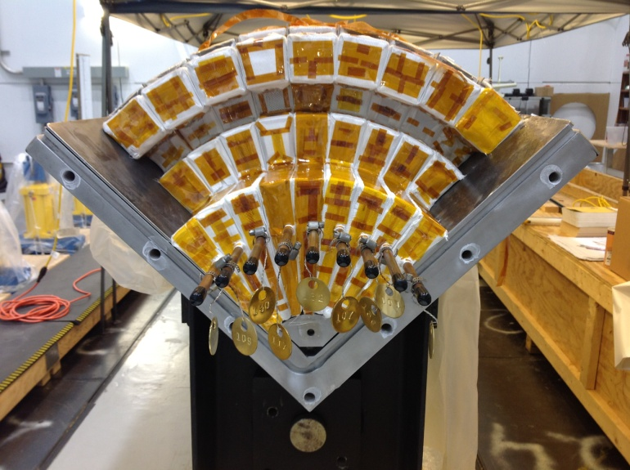
Step 2- Fabrication of Inner TF Bundle
Assemble individual conductors into Quadrant mold

Slide 11
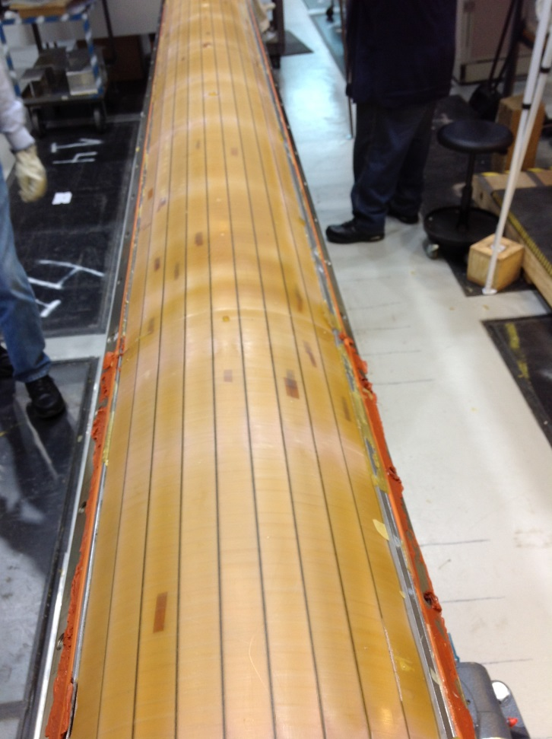
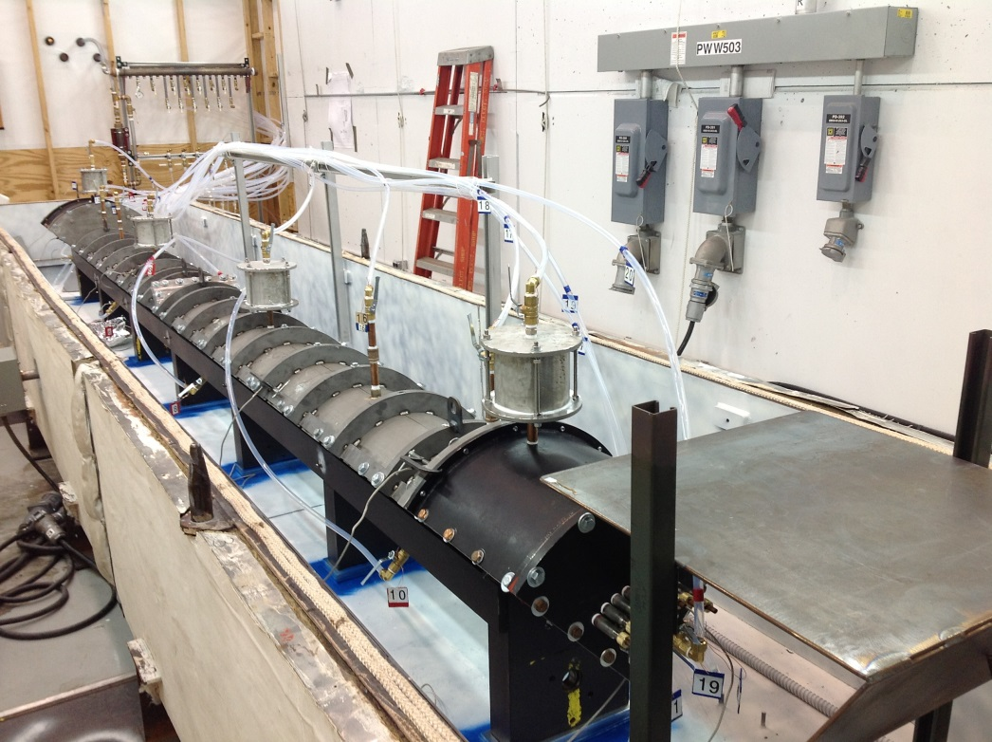
Step 3- Fabrication of Inner TF Bundle
The (4) TF Quadrants have been successfully VPI’d and electrically tested
Each Quadrant has 9 conductors

Slide 12
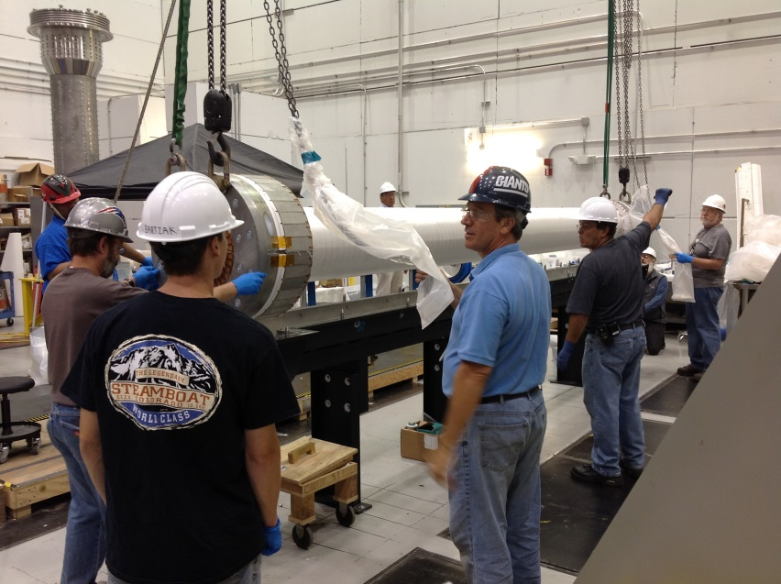
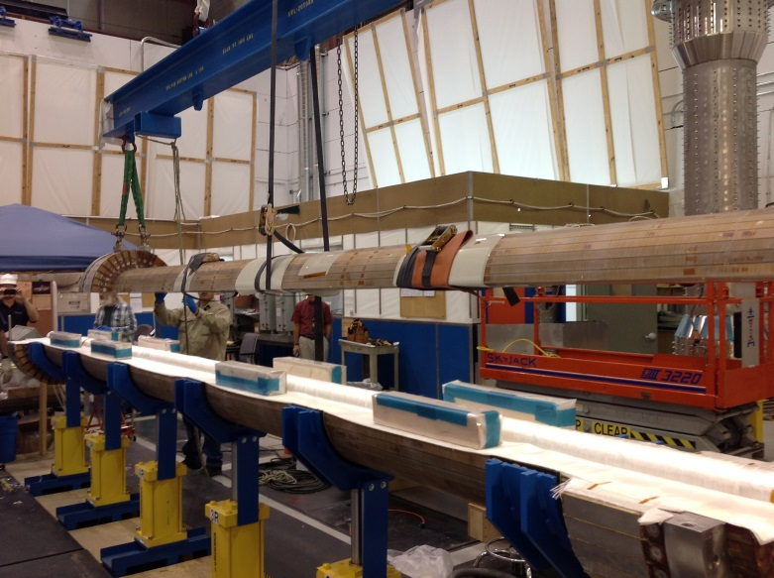
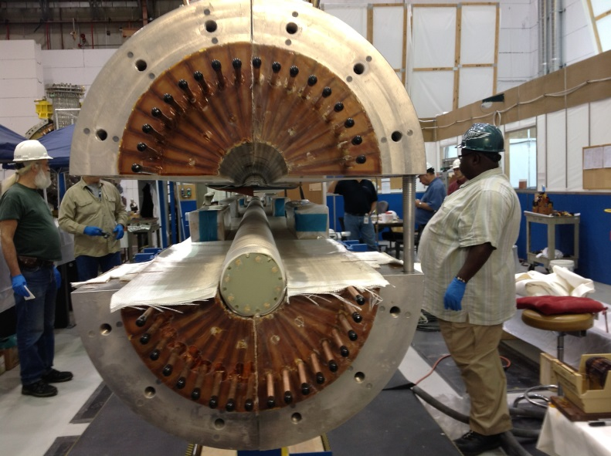
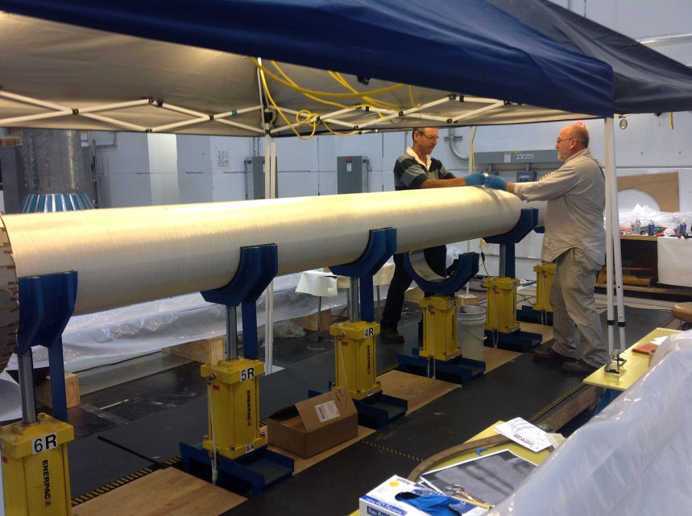
Step 4- Full TF Assembly
The four VPI’s quadrants were then assembled together to complete the full bundle.
The full TF bundle is placed into a mold and VPI’d
The quadrants will be assembled w/ S-2 between layers & pre-insulated G-10 core
Quadrants are ground wrapped with layers of S-2 glass tape
The full TF bundle is Ground wrapped with S-2 glass tape

Slide 13
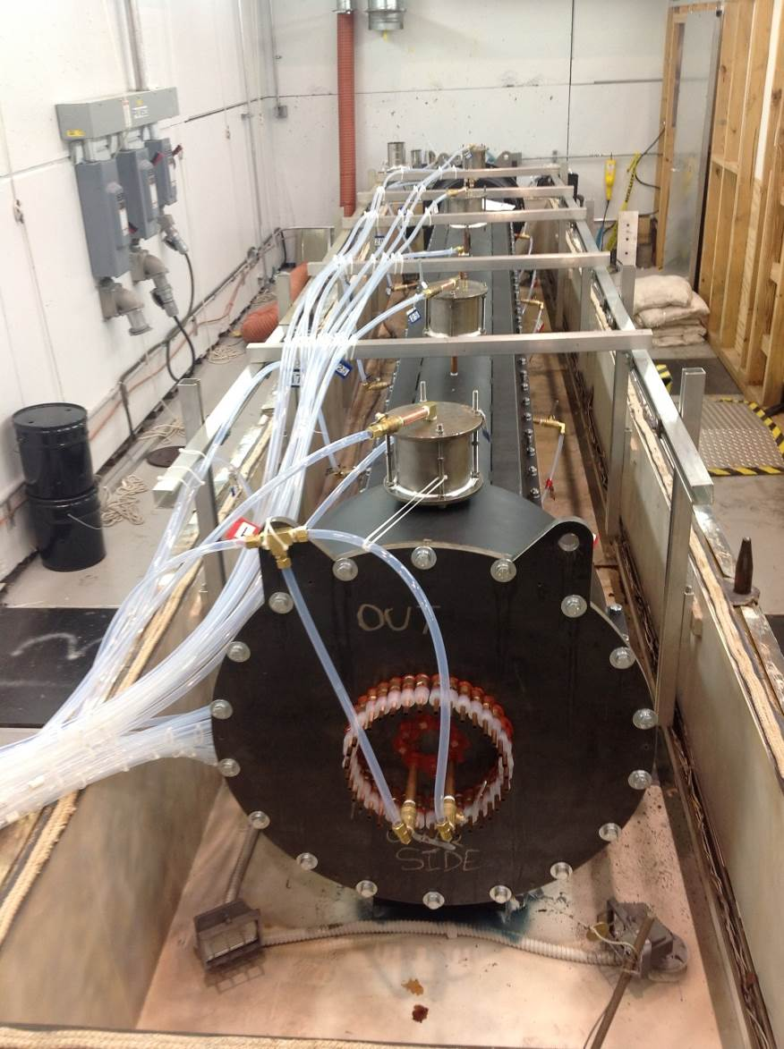
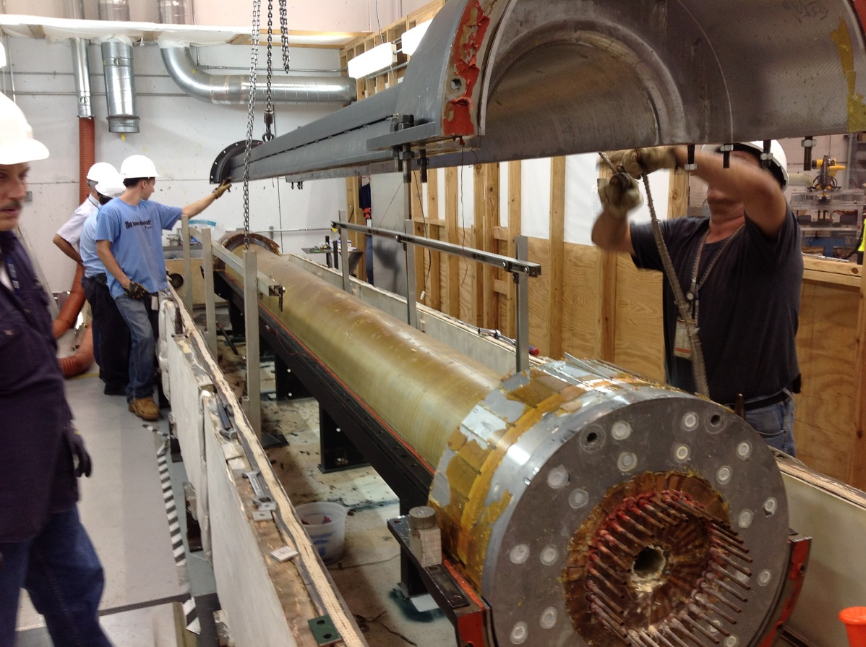
Step 5- Full TF Bundle Assembly
Full TF Bundle after VPI
Full TF Bundle in oven and ready for VPI

Slide 14
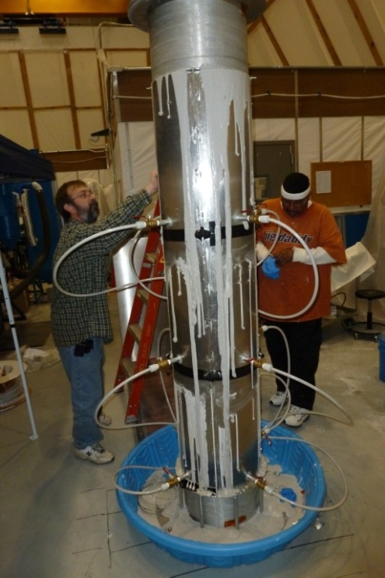
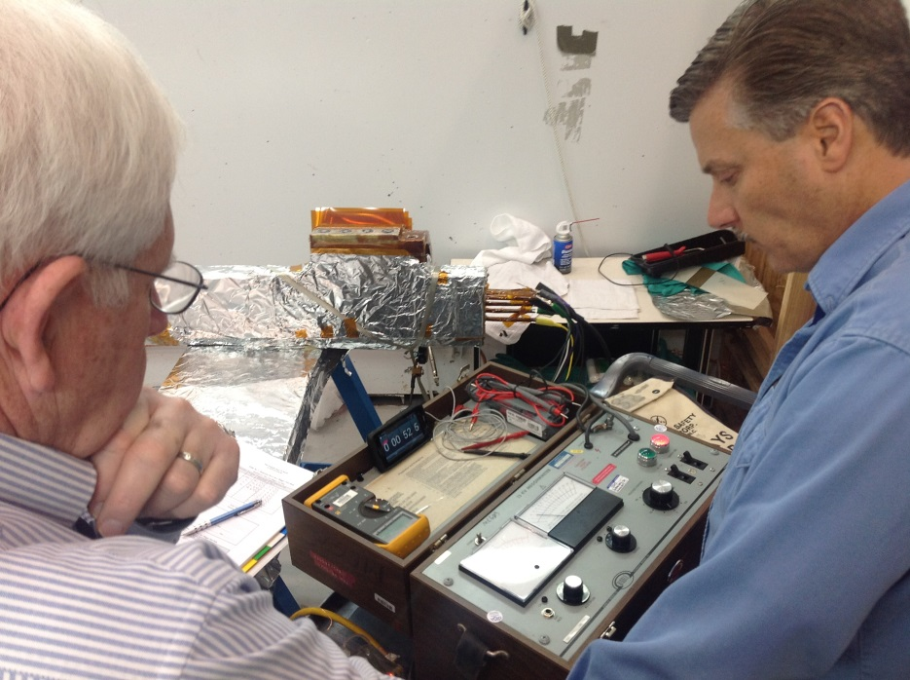
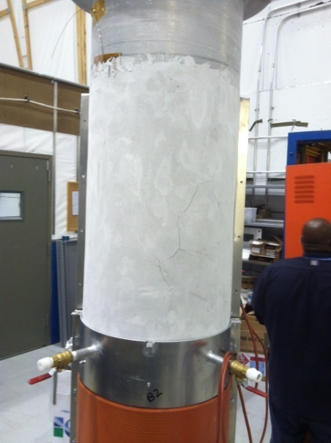
Step 6- Post VPI
Complete the electrical tests on TF bundle
Install the “Aquapour” filler over the TF bundle surface
  “Aquapour” is used as a temporary spacer that will be used to maintain 0.100 inch gap between the TF OD and OH ID surfaces. It is removed post VPI of OH coil
Mount TF Bundle into winding station
Begin winding operations

Slide 15
OH Solenoid Preparations
Preparations are underway for winding the OH solenoid
  OH conductor has been received, grit-blasted & primed √
  Insulation and epoxy has been received √
  Induction braze station for in line OH braze joints- has being commissioned √
  Pivot -beam (Conductor tension unit & taping machines) has been fabricated √
  OH Mold has been delivered √
  Area is being setup for fabrication √

Slide 16
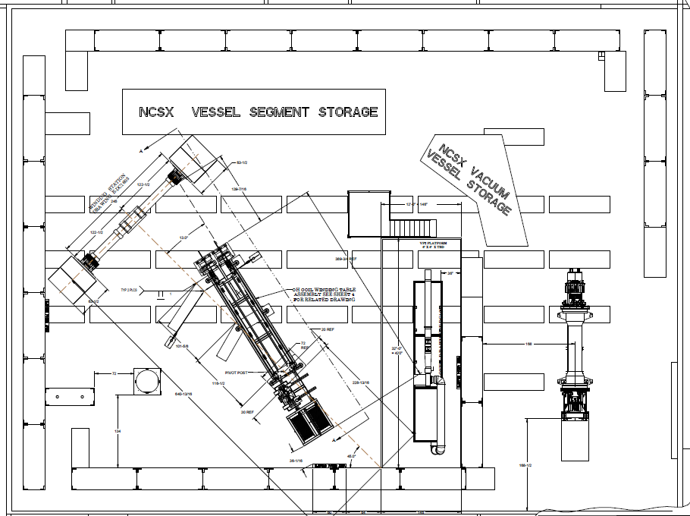
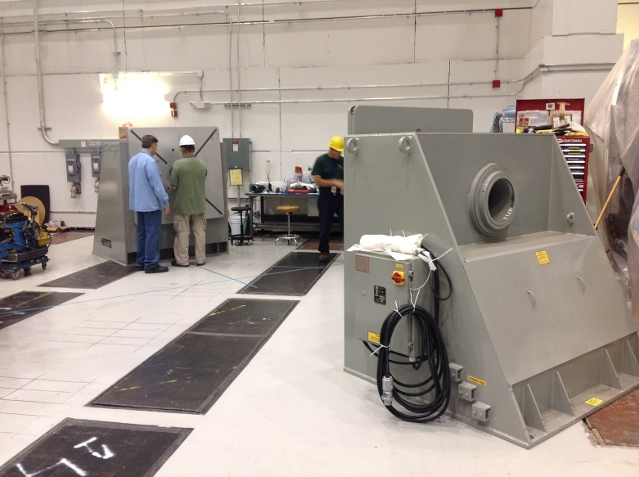
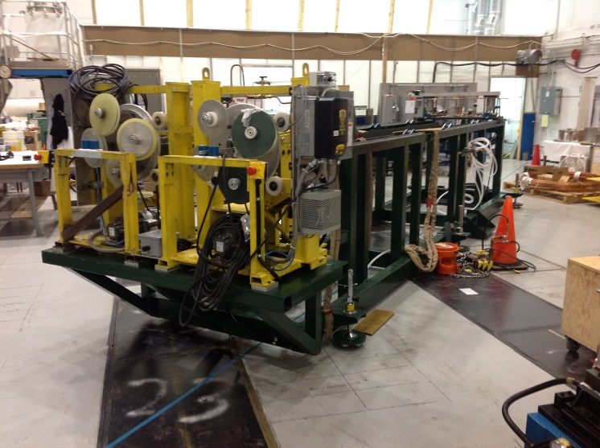
Fabrication of OH Solenoid
The OH Solenoid will be wound onto the Inner TF Bundle
The CS High Bay area is being reconfigured to wind the OH coil

Slide 17
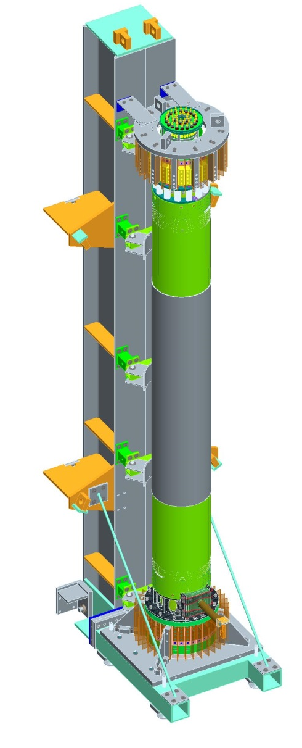
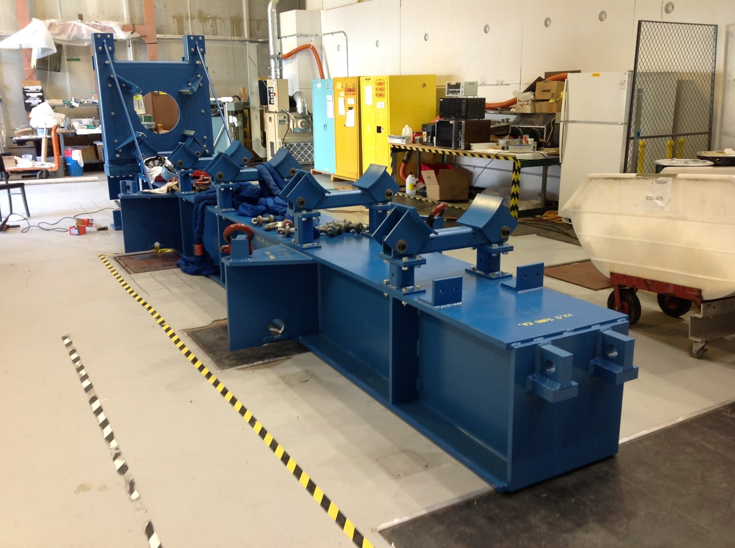
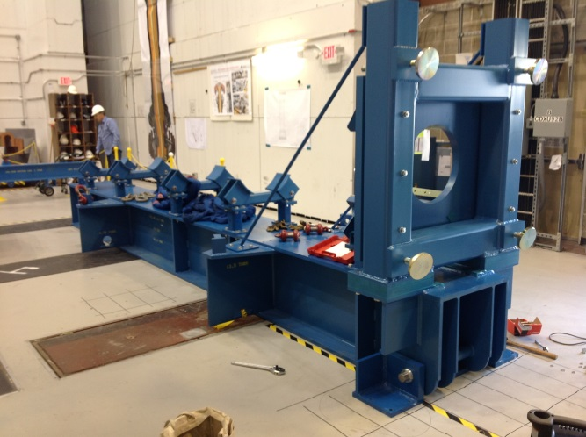
OH/TF Bundle Tooling
A new CS “Tilt Fixture” has been fabricated by Astro Machine Works Inc.
  Fixture will be used for up-righting the CS to the vertical position

Slide 18
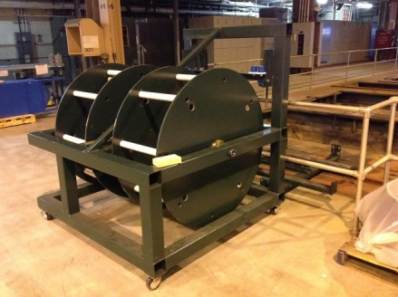
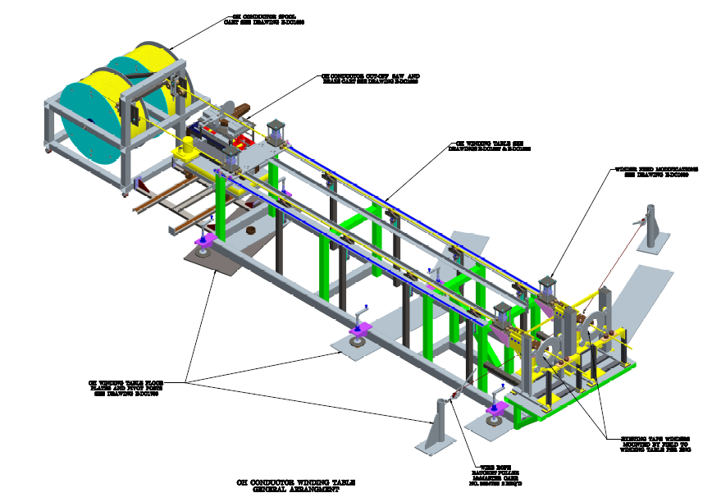
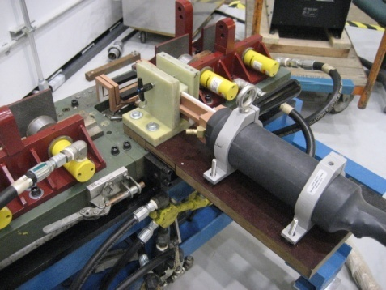
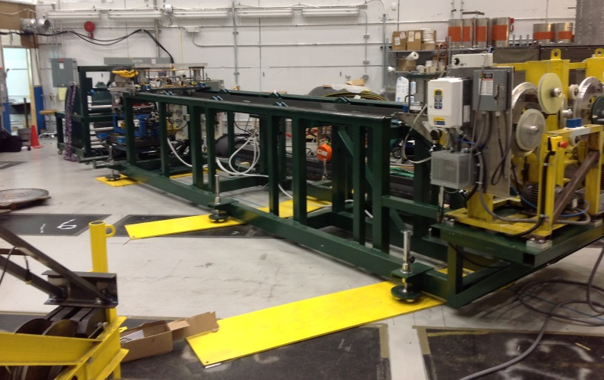
Tooling- OH Winding Station Pivot Beam
OH Winding station complete-manufactured by PPPL Shops
Copper Spools
Cut-off saw & Braze Station
Hydraulic Tension Unit
Dual Taping Heads

Slide 19
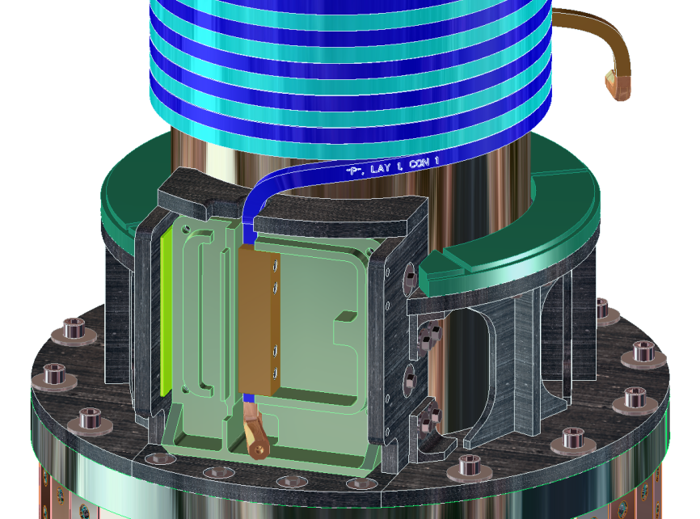
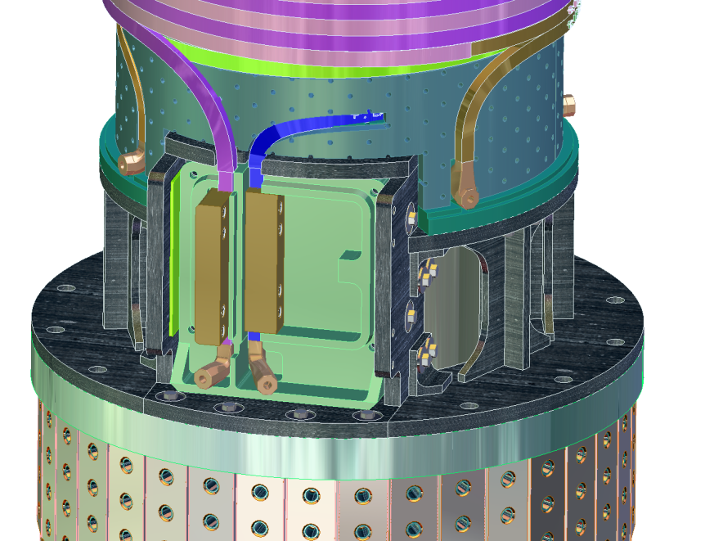
OH Solenoid Fabrication- 1
Wind the OH solenoid using approved drawings and procedure D-NSTX-IP-3385
Four layers/ 880 turns/ (2) conductors in-hand
Co-wound turn to turn insulation (Kapton/glass)
In-line braze joints
Layer to layer TIG Braze joints
Tension wound conductor

Slide 20
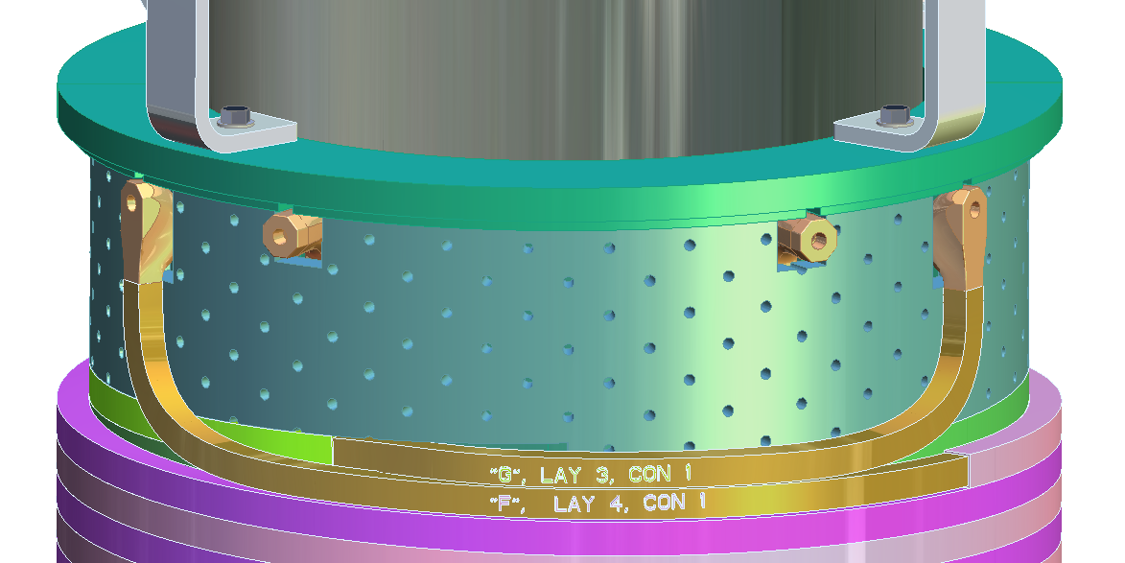
OH Solenoid Fabrication- 2
OH Cooling fittings- torch brazed to copper conductors
Glass/epoxy laminate fillers between layers supports turns
S-2 glass between fillers
Perforations in fillers will enhance epoxy flow during VPI
Layer to layer TIG-Braze joint [Typical]
“TIG-Braze”
  TIG-Brazing method minimizes annealing of conductors (use Sil-Fos)
  Provides adequate joint strength
  Qualified method and procedures used in previous OH solenoids
NSTX
NSTX Center Stack Upgrade Peer Review
April 29, 2010
20

Slide 21
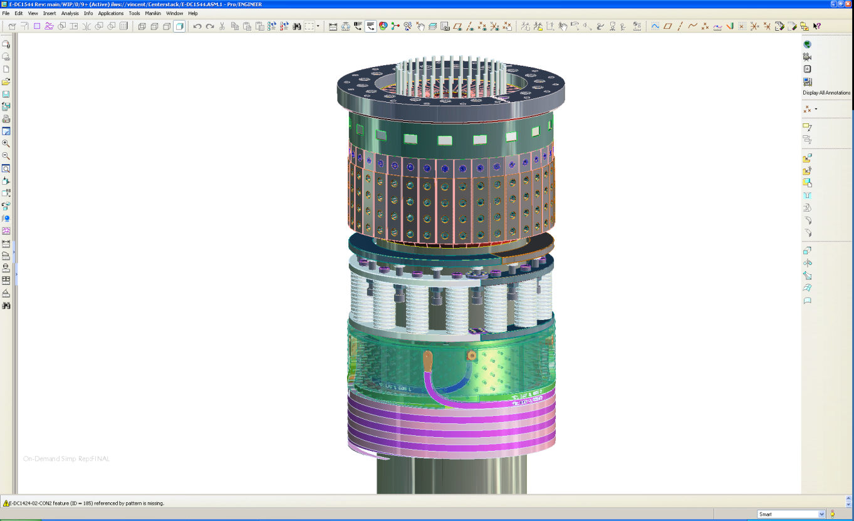
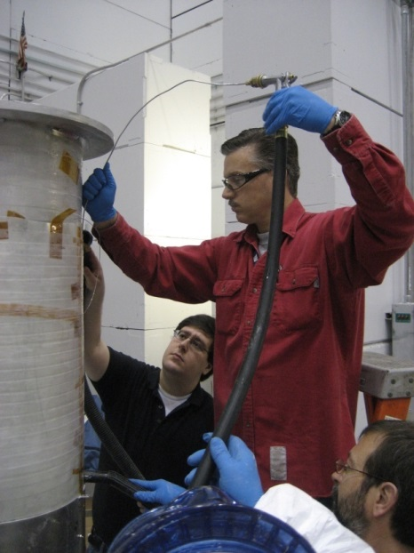
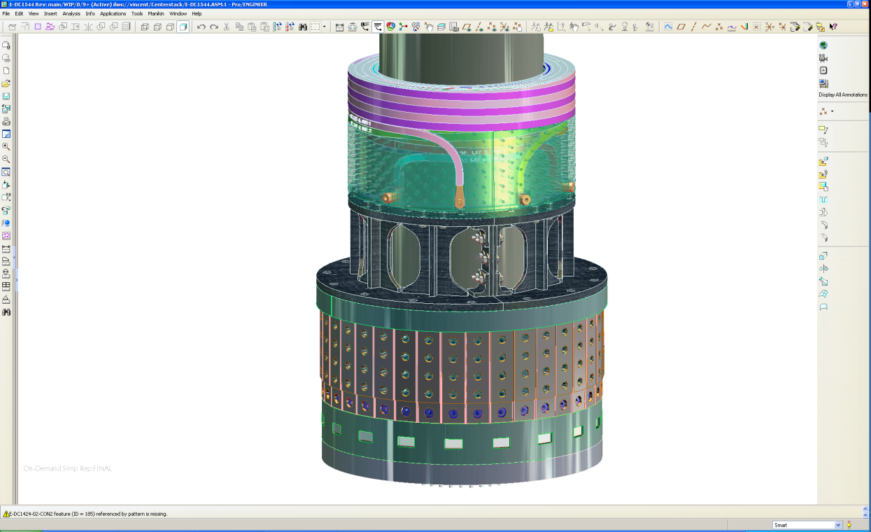
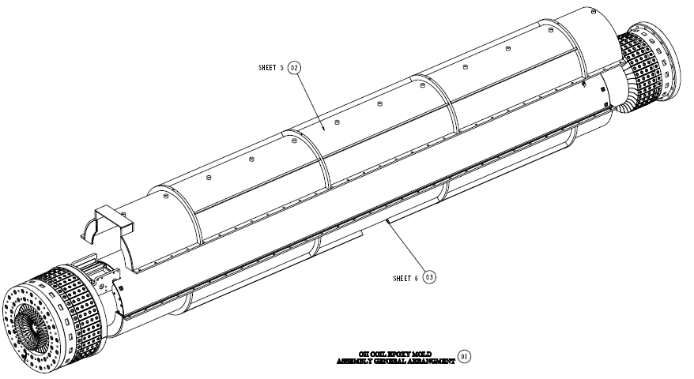
OH/TF Assembly Fabrication- continued
Complete the VPI of OH Solenoid
Remove “Aquapour” filler
Perform final electrical tests on systems
Begin final assembly activities
  OH ground wall preparations
  Micro-therm insulation blanket
  Upper and lower crowns
  Belleville washer assembly
  TF fittings completed
Final OH/TF/Casing assembly

Slide 22
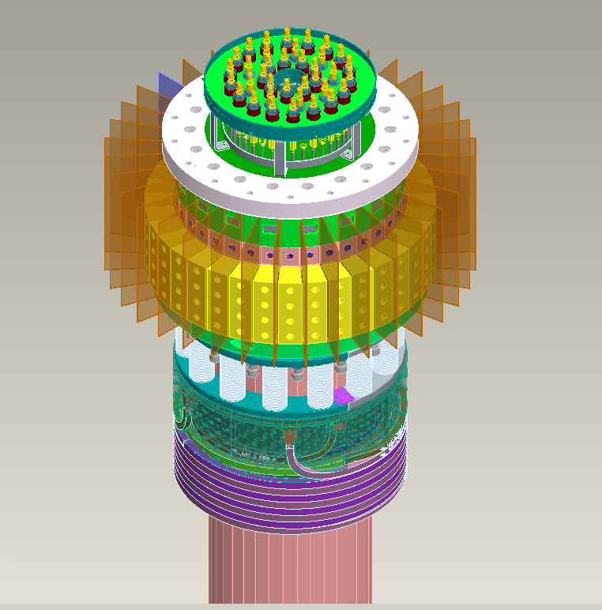
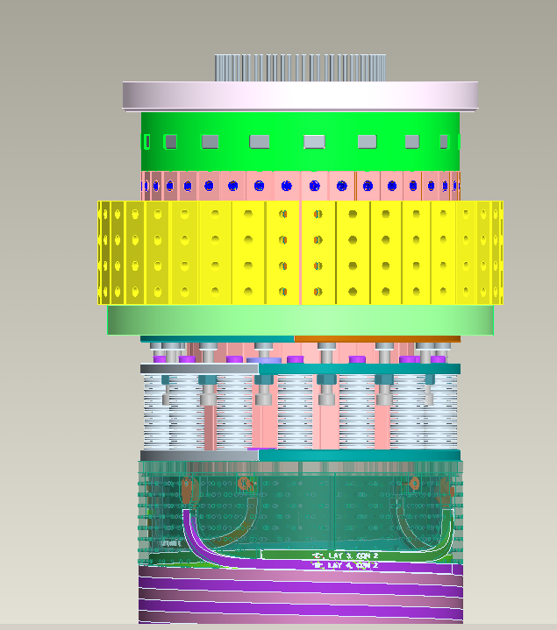
Final Assembly Tasks
Kapton/G-10 Flash shields between adjacent joint areas (after CS case is installed)
Purpose of Crowns: Lock conductors together & help transfer load from TF bundle through lid structure to umbrella
Cooling connections
Crown Assembly
TF inner Legs
Belleville Washer Assembly

Slide 23
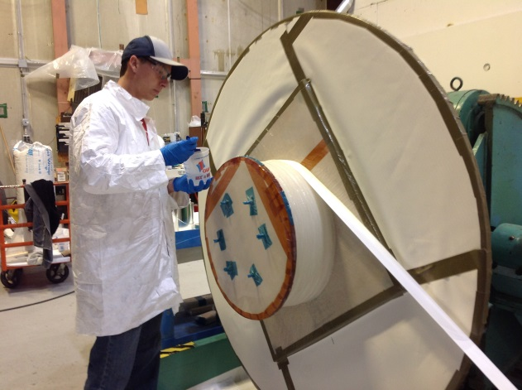
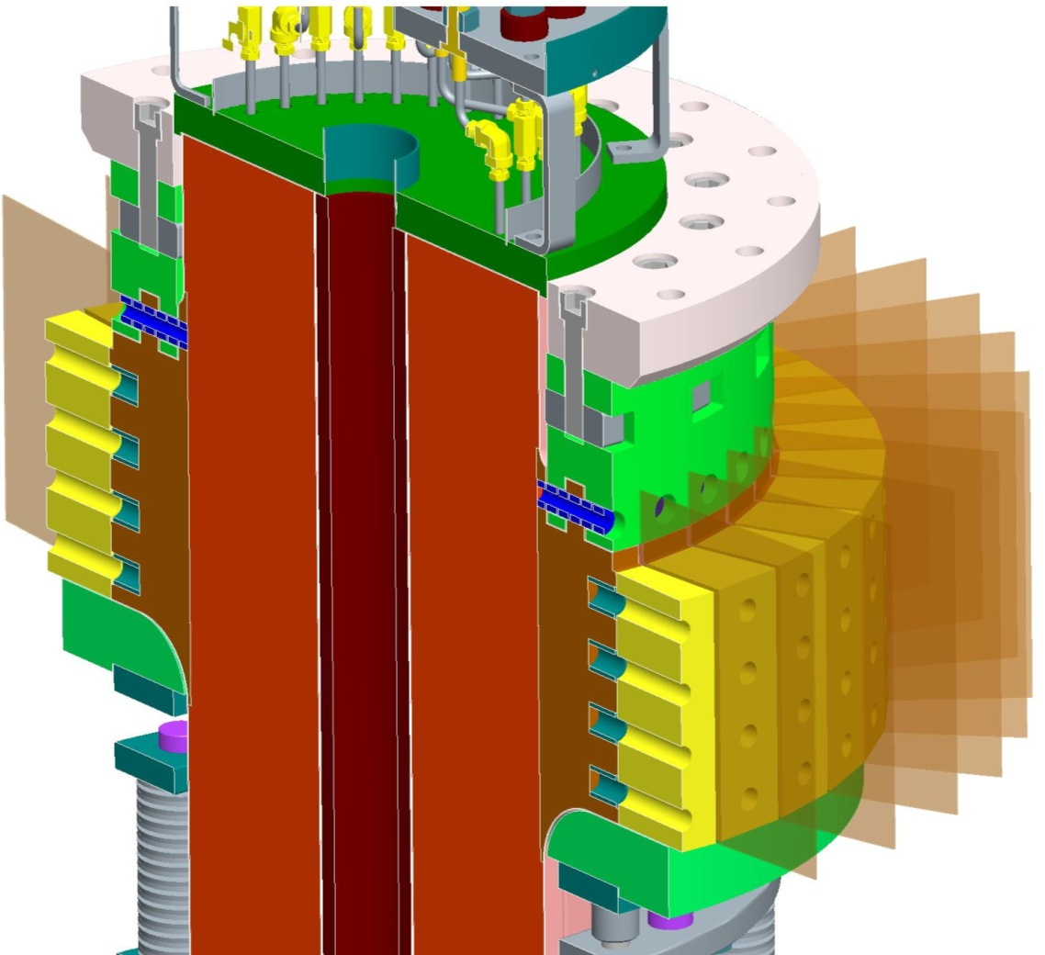
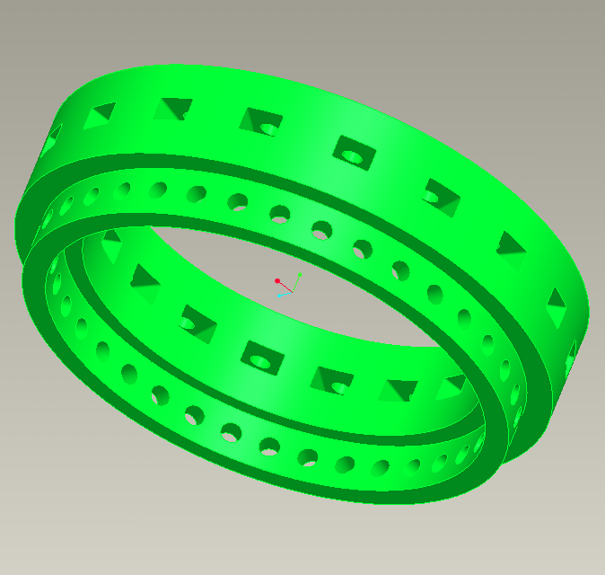

Upper & Lower Crown Assemblies-cont’d
Fabricate in house
Epoxy/S-2 glass construction circumferentially wound (jelly-roll)
Laminate Crown
Pinned to Inner TF Conductors 316 SS

Slide 24


Centerstack Casing
The Centerstack Inconel casing has been manufactured by Martinez & Turek located in California.
Inconel studs for supporting the PFC’s have been installed

Slide 25



Centerstack Casing
Once the Inner PF1B coils have been installed, the PFC tiles and diagnostics will be mounted.
PF1B
Plasma Facing Component tiles

Slide 26



Inner PF Coils
Contract for fabricating the Inner PF coils has been awarded to Everson-Tesla Inc. (Nazareth, Pa)
A delay due to problems with their sub-contractor for fabricating the coil support structures (winding forms) has cause several months of delay.
Everson-Tesla has since fired their contractor and has contracted with another with better results.
The first Inner PF coil is now scheduled for delivery in November.
Late delivery has no impact on critical path schedule
PF1A
PF1B
PF1C

Slide 27



Miscellaneous Procurements
TF flex buss has been completed by Zenox Corp.
Super nuts and hardware have been delivered
Outer TF Lead extensions are in procurement-
  A development program was needed to finalize the method for joining these components.
  E-beam welding was selected with best results
MT Torque-nut™
OTF Lead Extensions
Flex-Bus (Cu-Cr-Zr)

Slide 28


Outer TF Coils
(2) Outer TF coils were fabricated by Everson-Tesla Inc.
Coils have been delivered and installed in the machine

Slide 29


Complete Ceramic Break Sub-Assembly
Assemble the ceramic break components to the Upper and Lower PF-1C coil structures. Work to be performed by PPPL
Ceramic rings were fabricated by Kyocera in Japan
Stainless rings manufactured by Hollis Machine (NH)
G-11 insulators manufactured by Astro Machine Works (Pa) and Reno Machine (Conn)
PF1C coil manufactured by Everson-Tesla Inc
Exploded View
Assembled View

Slide 30



Step 1- Assemble CS Support & Lower PF-1A Together
Install “Micro-therm” insulation around outside surfaces of “Upper PF1” Coil
Mount the Center Stack Support Structure to Lower PF-1A Coil

Slide 31


Step 2- Assemble Lower PF-1A Assy. To OH/TF Assy.
Position the Lower PF-1A coil assembly over the OH/TF Assembly

Slide 32

Step 3 – OH Diagnostics & Thermal Blanket
Micro-Therm Insulation
Mount the OH surface diagnostics and the “Micro-Therm” Insulation Blanket around the outer surfaces of the OH Solenoid
Flux loops
Thermocouples
Rogowski Coils
Lower PF-1A Coil Assy.

Slide 33



Step 4 – Install CS Casing to CS Assembly
Lower the CS Casing over the OH/TF Assembly
Lower the Upper PF1A coil over the OH/TF Assembly & secure to Upper PF1B coil
Upper Assembly
Lower Assembly
Transport components to NSTX High Bay Area for assembly

Slide 34


Step 5- Install Completed CS Assembly
Install the completed Center Stack Assembly into the Vacuum Vessel (Spring 2014)
Pre-position the lower Ceramic Break Assembly and Rotatable Flange prior to lowering CS assembly into the VV

Slide 35
Conclusion
Four TF Quadrants and the full TF bundle have been VPI’d (Retired risks)
  Five of the 6 required VPI’s have been completed
The manufacturing of the TF bundle has been completed
The OH coil manufacturing facility is being setup
Major tooling for the OH solenoid has been completed
The OH conductor sandblast/priming has been completed
The Inconel casing has been delivered
OTF’s have been completed and installed (Everson-Tesla)
Contract for Inner PF coils has been awarded to Everson-Tesla
Anticipate delivery of the Centerstack components to NSTX Test Cell in May 2014

