Slide 1



NSTX-U
Supported by
Machine Installations and
Construction Management
Coll of Wm & Mary
Columbia U
CompX
General Atomics
FIU
INL
Johns Hopkins U
LANL
LLNL
Lodestar
MIT
Lehigh U
Nova Photonics
Old Dominion
ORNL
PPPL
Princeton U
Purdue U
SNL
Think Tank, Inc.
UC Davis
UC Irvine
UCLA
UCSD
U Colorado
U Illinois
U Maryland
U Rochester
U Tennessee
U Tulsa
U Washington
U Wisconsin
X Science LLC
Culham Sci Ctr
York U
Chubu U
Fukui U
Hiroshima U
Hyogo U
Kyoto U
Kyushu U
Kyushu Tokai U
NIFS
Niigata U
U Tokyo
JAEA
Inst for Nucl Res, Kiev
Ioffe Inst
TRINITI
Chonbuk Natl U
NFRI
KAIST
POSTECH
Seoul Natl U
ASIPP
CIEMAT
FOM Inst DIFFER
ENEA, Frascati
CEA, Cadarache
IPP, Jülich
IPP, Garching
ASCR, Czech Rep
Erik D. Perry
Princeton Plasma Physics Laboratory
NSTX Upgrade Project
Office of Science Review
LSB B318
December 11 - 12, 2012

Slide 2
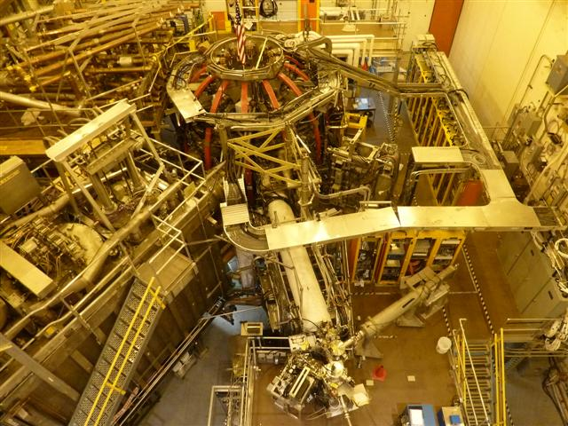
Topics
Outage planning
Outage Coordination
Safety and Efficiency
Outage planning for diagnostics calibrations and out of scope tasks
Outage progress since May
Installation risks and mitigations
Plans for next four months
NSTX before outage

Slide 3
NSTX Upgrade Outage
A plan has been developed for performing the NSTX Upgrade Outage
  Based on experience from similar outages since 1984
  Plan is being continually improved as opportunities arise
A system for coordinating and controlling the outage tasks is in place
  Based on the very successful Work Control Center that was used during the TFTR D&D Project
    Assuring safety, efficiency and correct performance

Slide 4
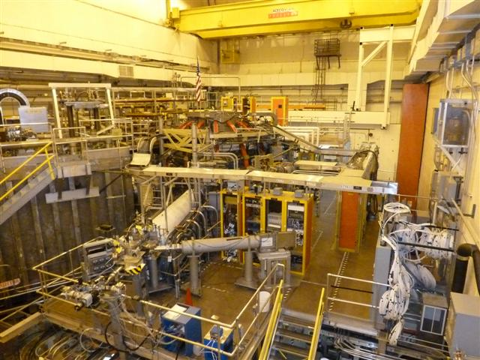
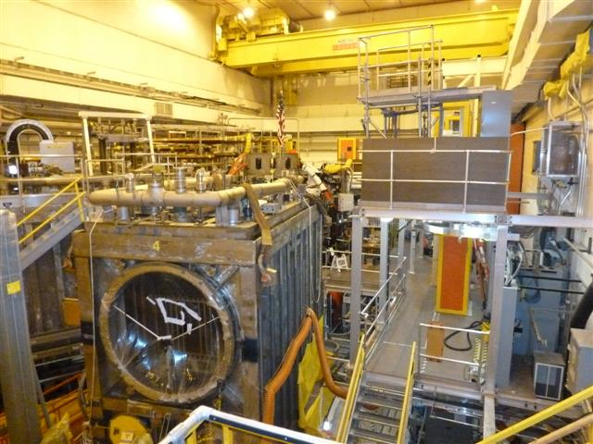
Outage Planning
Outage planning based on bottoms-up estimates from Engineering
  Assumes one shift, 5 days per week for almost all work
Assigns technicians, by name, to scope to assure staffing requirements are met
Adjust start date of tasks to assure tasks in the same area are compatible
Accelerating tasks that make other tasks safer or more efficient
Peel back cabling and fiber optics, rather than removing them
October 2011 November 2012

Slide 5
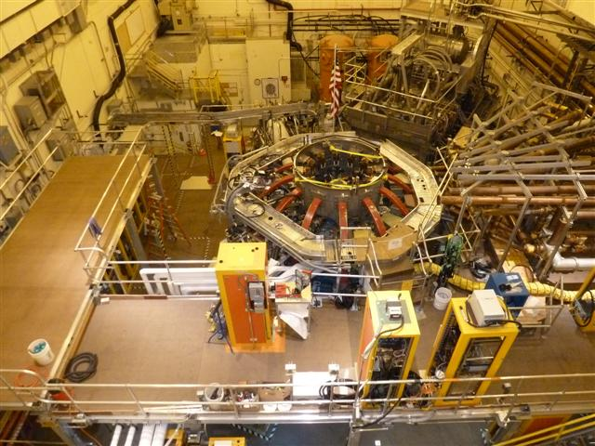
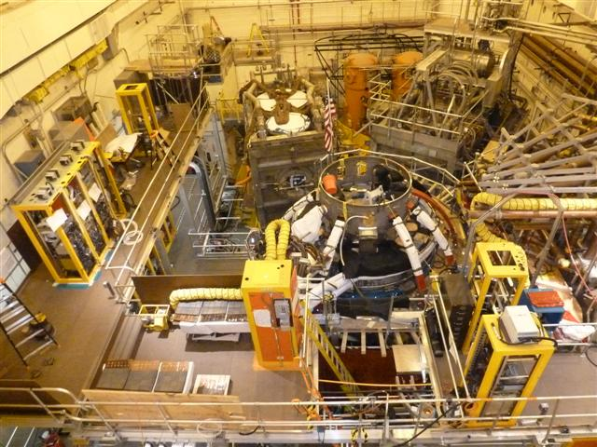
Outage Planning ^{cont}
Work in Bays J, K and L most congested
  Neutral beam installation, including cutting large hole in vessel
  Coil supports and umbrella modifications for center stack
  Diagnostic relocations, including cutting large hole in vessel
Work crews on opposite sides of vacuum vessel or on different shifts
Pre-plan temporary storage areas to minimize handling
Daily / hourly coordination of all field work is critical
November 2011 November 2012

Slide 6
Outage Coordination
Use of Work Control Center (like TFTR D&D Project)
Work Control Center reviews all Engineering Work Packages for the field
  Reviews Job Hazard Analysis (JHA)
  Assures pre-requisites are done
  Attends pre-job and post-job briefs
  Interfaces between Engineering and the field crews
  Assures that the field work is done safely and correctly
  Assures that the field crews are used efficiently
Daily Plan-of-the-day meetings to coordinate activities between crews and fine tune technician assignments
  Includes field crew leaders, QA, Safety, Health Physics, Industrial Hygiene, DOE
12/7/11 12/14/11 Set up for machining o-ring groove in upper flange

Slide 7
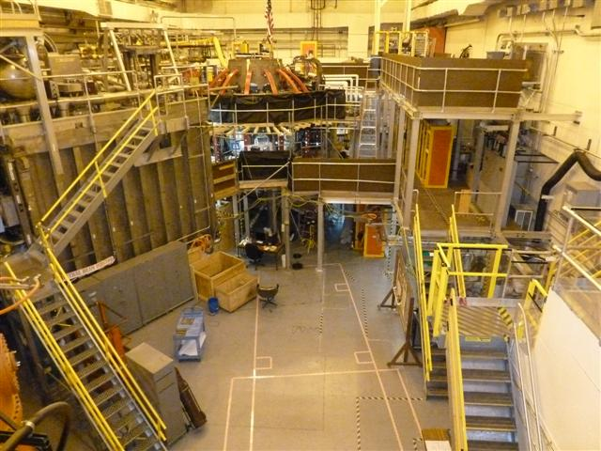
Outage Planning Adjustments
Plan of the Day meetings
  Adjustments made based on actual progress and manpower availability
Work Control Center weekly meetings
  Adjustments made based on projected availability of parts and procedures
Weekly rollover meeting
  Adjustments made based on 2 – 3 month look-ahead at all field/shop work
Flexibility for adjustments comes from
  Second shift work
  Multiple crews working on opposite sides of vessel
  Temporary platforms to improve safety of access even after parts are out
  Trial fit-ups to minimize time spent on NSTX
  NSTX just before NB2 moves in

Slide 8
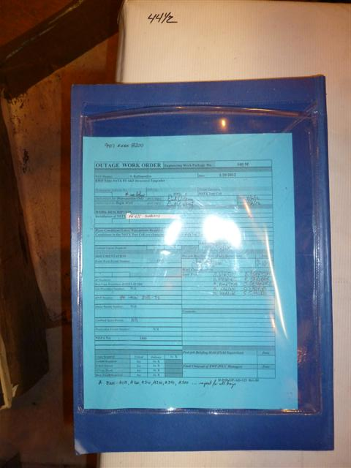
Safety and Efficiency
Work Control Center review of all procedures and engineering work packages
Plan of the Day meetings with field supervisors and shop supervisors
Multiple crews working on opposite sides of vessel
Temporary platforms to improve safety and access
Trial fit-ups to verify handling techniques
All work in NSTX Test Cell being done with Engineering Work Packages (90 packages so far, 39 completed)
  Written procedures
  Permits
  Job hazard analysis
  Permits: confined space, hot work, radiation work, penetration, etc
  Pre-job and post-job briefings

Slide 9
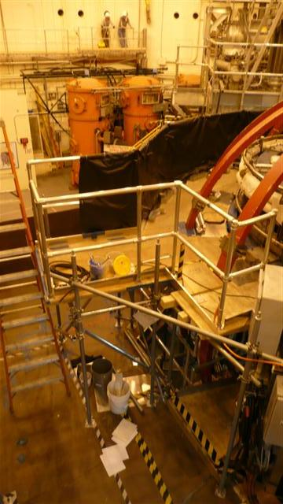
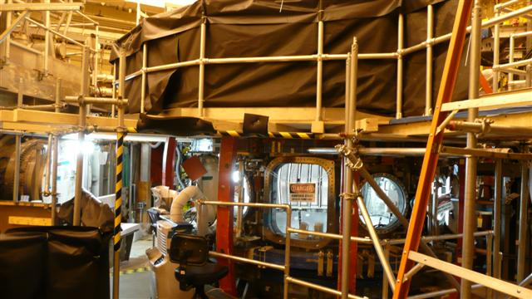
Safety and Efficiency
Installed extensive scaffolding to facilitate access to the upper and lower domes of the vacuum vessel
  Improved safety for workers – full handrails and toeboards
  Improved efficiency of removal, installation and welding tasks
  Inspected every shift as required by OSHA

Slide 10
Outage Planning for Diagnostic Calibrations
Diagnosticians have listed the calibrations they would like prior to re-starting NSTX
Detailed schedules for these calibrations are being prepared
  Schedules will be fit into the existing outage schedule
  Each calibration will be scheduled as early as possible to avoid delays once the installation work has been completed
  Calibrations may be scheduled to occur after the Upgrade Outage if they are not required for CD-4 or early operations

Slide 11
Outage Planning for Work Outside Project Scope
Work in the NSTX Test Cell that is not part of the Upgrade Project will follow the same process as all work performed there
  Will require an Engineering Change Proposal (ECP) approved by the Upgrade Project
  Will require a Work Approval Form and a detailed job estimate that is reviewed and approved by the Engineering Department
  Will require its approved estimates and schedule be added to the Primavera database so it can be tracked alongside the tasks for the Upgrade Project
  Will require an Engineering Work Package that has been approved by the Work Control Center
    Written procedure
    Job Hazard Analysis
    Approved permits as required
    Pre-job and post-job briefings
  Will require persons approved to be in the NTC to perform the work under the supervision of the Work Control Center

Slide 12
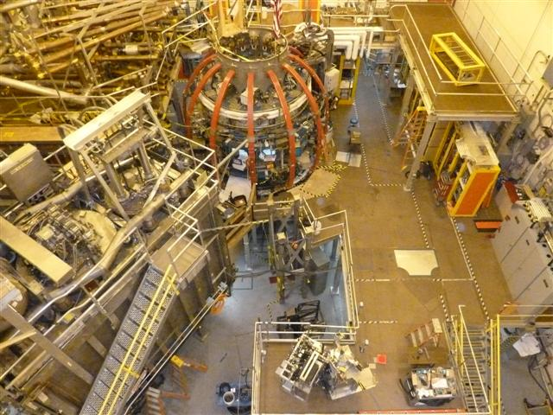
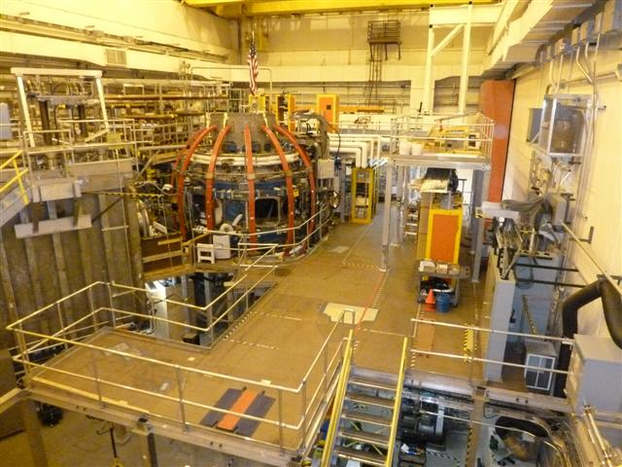
Outage Progress
Removals to make room for Neutral Beam #2

Slide 13
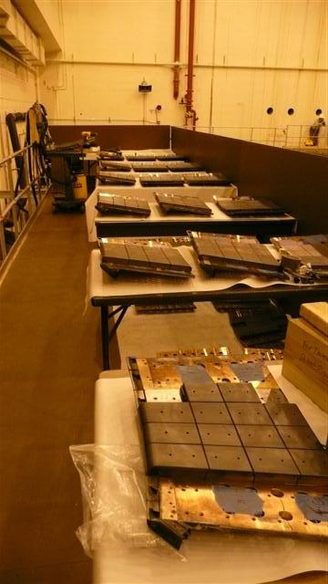
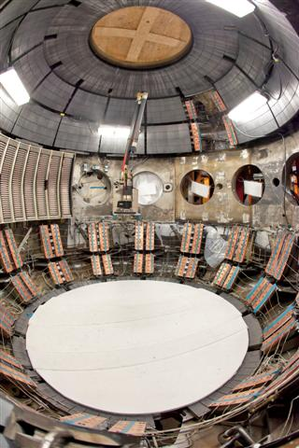
Outage Progress
Changed mounting hardware for passive plates and re-installed them

Slide 14
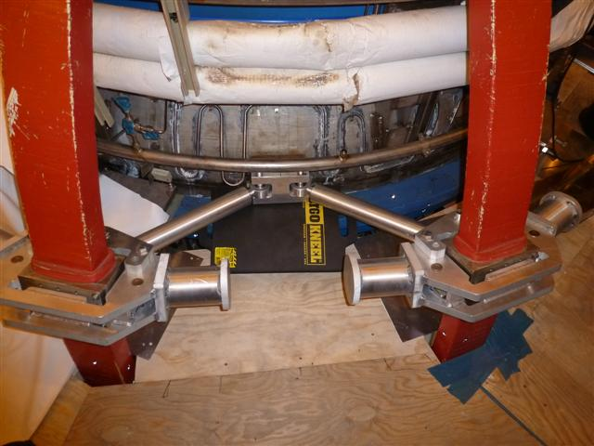
Outage Progress
Installation of new TF clevis blocks on the vacuum vessel

Slide 15
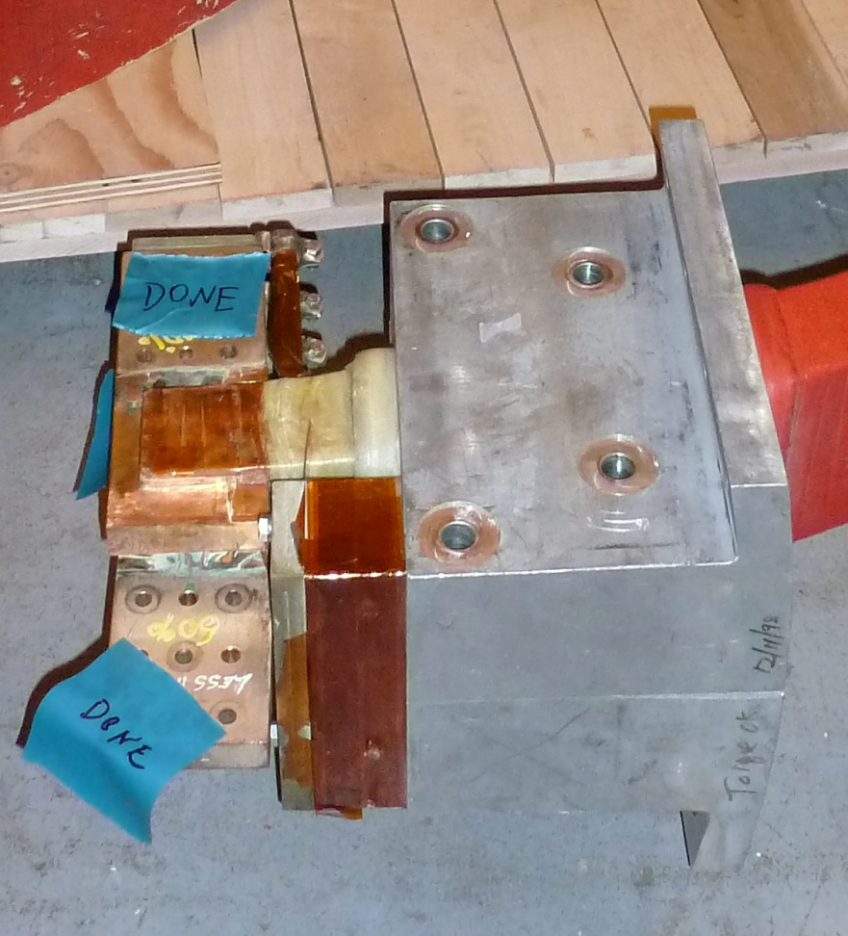
Outage Progress
Flags on outer TF legs modified
  Additional holes drilled
  Flags straightened
  Flags ultrasonically tested to verify braze joints

Slide 16
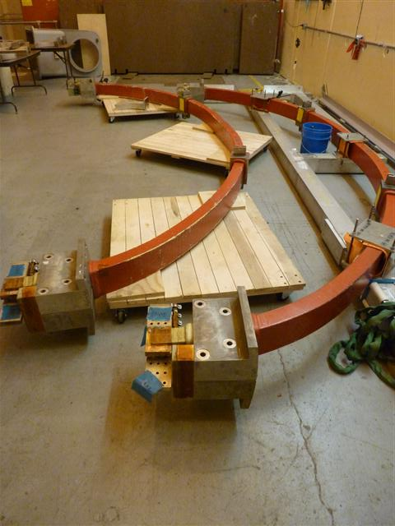
Outage Progress
Removal of TF outer legs that need to be repaired or replaced
  Completed with minimal removal of surrounding items
  Replacements must be completed before significant re-installations can occur

Slide 17
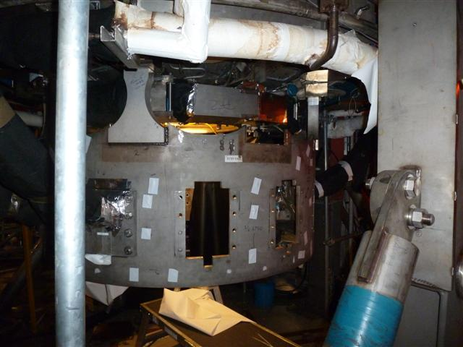
Outage Progress
Installation of new umbrella legs (upper and lower)
  Utilized a crew to prep welding area and parts to minimize welder time
  (since welders are a limited resource and we need to carefully manage their use)

Slide 18
Outage Progress
Replace upper and lower PF2/3 hardware and add new clamps
  95% complete
  ****

Slide 19
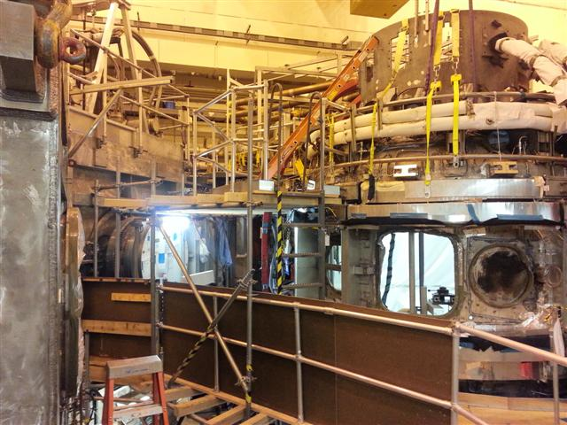
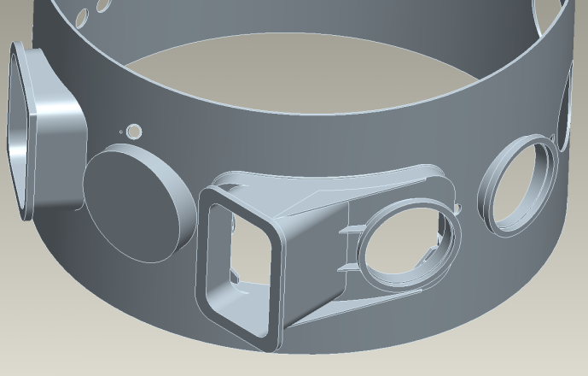
Outage Progress
Removal of old vacuum vessel nozzles at Bays J and K
In-vessel set-up for vacuum vessel cutting
  Installing support beams, containment and ventilation
Ex-vessel set-up for vessel cutting
  Installing containment and ventilation

Slide 20
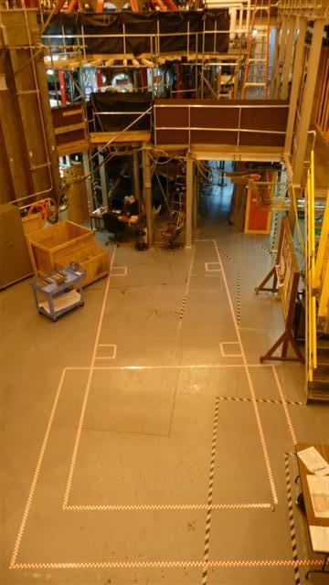
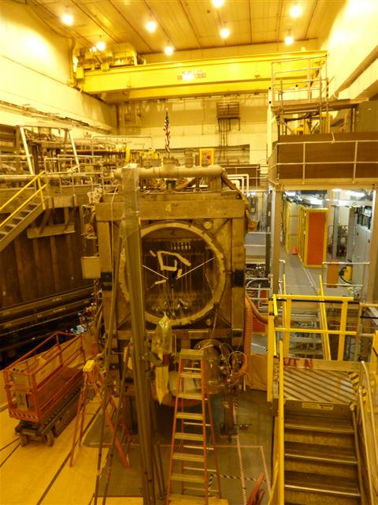
Outage Progress
Installation of second neutral beamline started
Moved Neutral Beam #2 (NB2) enclosure into NSTX Test Cell (NTC)
Installed lid with cryo panels on NB2 in NTC
Welded legs on NB2
Initial alignment of NB2 completed

Slide 21
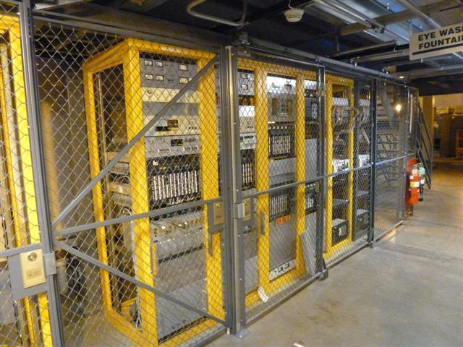
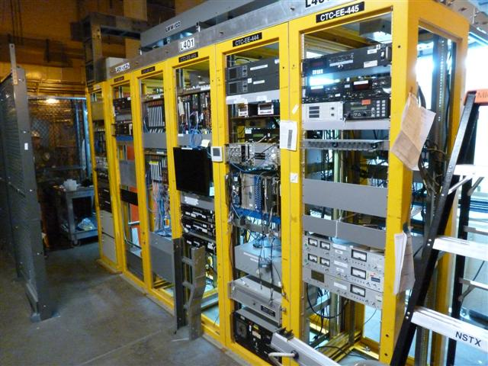
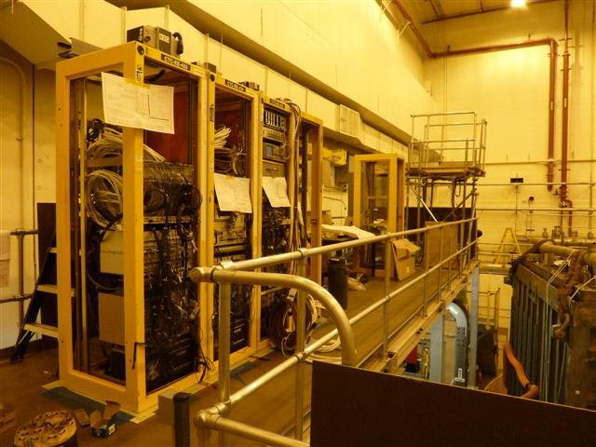
Outage Progress
Re-installation of cable trays and racks started

Slide 22
Machine Installation Risks and Mitigations
Delays in getting parts delivered to installation crews
  Re-schedule work sequence
  Schedule work on two shifts once parts arrive
Scope creep
  Engineering Change Proposal process
  Review of engineering estimates by division heads (WAF review)
Fit-up of new centerstack
  Estimate includes three fit-ups
Re-installation requirements for some diagnostics not well defined
  Diagnostics in process of defining requirements or electing not to re-install some items

Slide 23
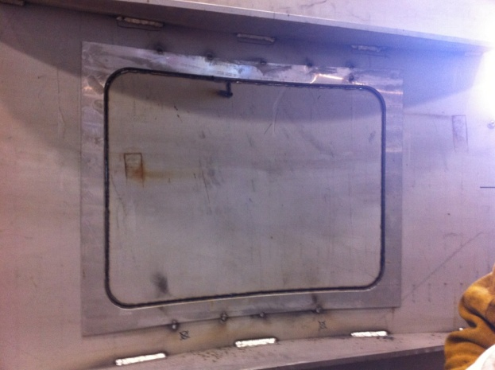
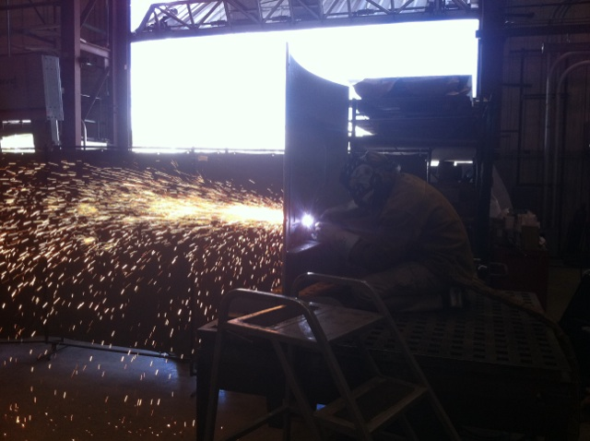
Plan for December 2012
Vessel cutting at Bays J and K for new neutral beam port
Weld JK cap onto vessel

Slide 24
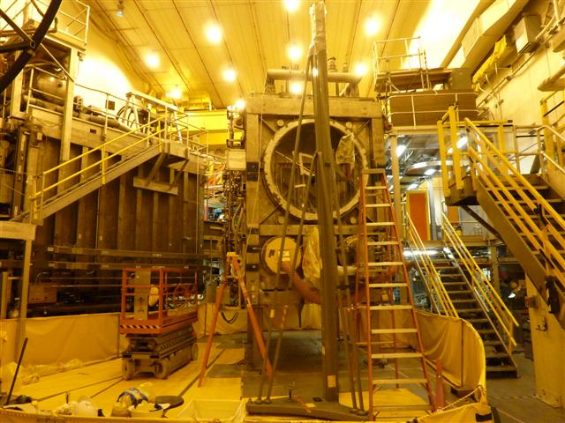
Plan for December 2012 – January 2013
Install TIV and 90” flange on NB2 so it can be closed up
Decon exterior of Neutral Beam #2

Slide 25
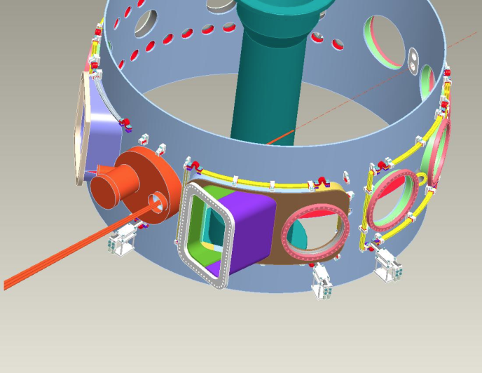
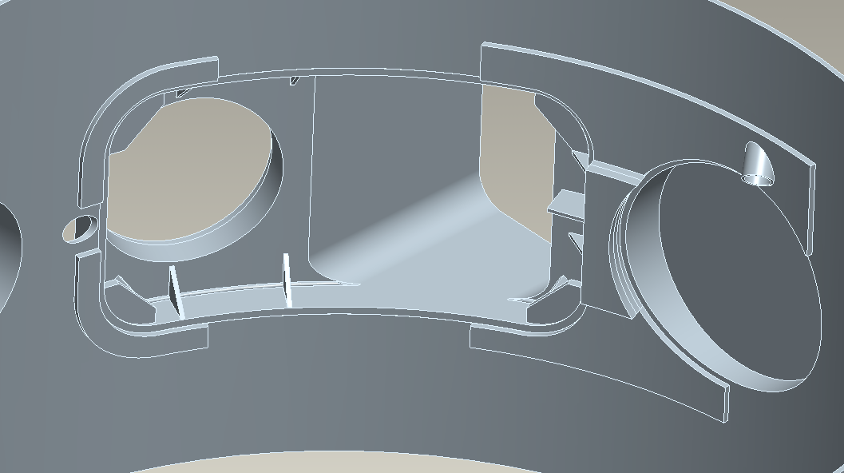
Plan for January 2013
Ex-vessel set-up for cutting at bay L
  Installing containment and ventilation
Vacuum vessel cutting at Bay L for new diagnostics port
Remove temporary in-vessel beams and ventilation
Leak check welds on Bays JK cap
Remove platform at Bays JKL

Slide 26
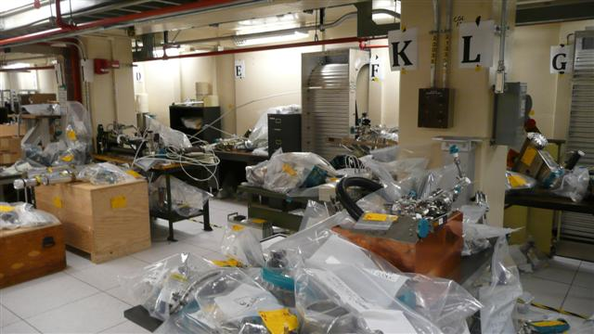
Plan for December 2012 – March 2013
Complete modifications to umbrella and coil supports
Complete Neutral Beam systems
Re-install items removed for centerstack work
Re-install items removed for NB work

Slide 27
Summary
The NSTX Outage has been planned based on
  Bottoms-up estimates from Engineering
  Identifying staff to do the work
  Scheduling work to avoid conflicts
The plan is being continuously worked
  To improve safety and efficiencies
  To deal with delays in getting parts
  To accelerate tasks to ease pressure on critical path tasks
Coordination and Control
  Provided by the Work Control Center
  At the Plan-of-the-day meeting
  Continuously by the Field Supervisors
Successfully performing the outage

