Slide 1



NSTX-U
Supported by
NSTXU NBI Upgrade Overview
Timothy N. Stevenson
Coll of Wm & Mary
Columbia U
CompX
General Atomics
FIU
INL
Johns Hopkins U
LANL
LLNL
Lodestar
MIT
Lehigh U
Nova Photonics
ORNL
PPPL
Princeton U
Purdue U
SNL
Think Tank, Inc.
UC Davis
UC Irvine
UCLA
UCSD
U Colorado
U Illinois
U Maryland
U Rochester
U Tennessee
U Tulsa
U Washington
U Wisconsin
X Science LLC
Culham Sci Ctr
York U
Chubu U
Fukui U
Hiroshima U
Hyogo U
Kyoto U
Kyushu U
Kyushu Tokai U
NIFS
Niigata U
U Tokyo
JAEA
Inst for Nucl Res, Kiev
Ioffe Inst
TRINITI
Chonbuk Natl U
NFRI
KAIST
POSTECH
Seoul Natl U
ASIPP
CIEMAT
FOM Inst DIFFER
ENEA, Frascati
CEA, Cadarache
IPP, Jülich
IPP, Garching
ASCR, Czech Rep
Princeton Plasma Physics Laboratory
NSTX Upgrade Project
Office of Science Review
PPPL LSB 318
10/02/13 - 10/03/13

Slide 2
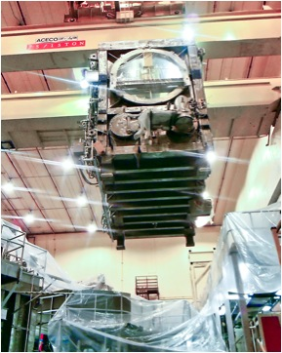
GRD Requirements for NBI System
Disassemble & evaluate a TFTR BL ☑
Decon a TFTR DT BL ☑
Refurbish BL ☑
Lift BL over wall – Clearance OK ☑
Add second NBI & Services in NTC ☑
Connect Power & Controls ☑
Aim wider (modify VV) ☑
Rearrange NTC to fit ☑
Capability to run either or both ☑
NBI Power x 2 for NSTXU ☑

Slide 3
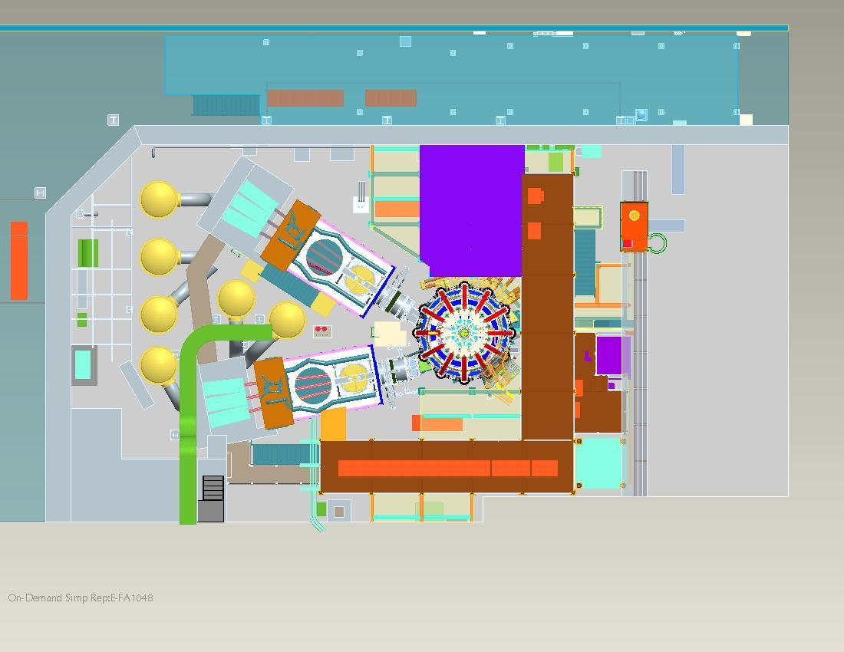
NSTXU Test Cell General Arrangement
New Racks
NSTX Gallery/DARM
BL1
Platforms
NSTXU
HVE
BL2
NBI Duct/TVPS
Helium Cryo Lines
Power cables
TTC South Wall

Slide 4
D Site Buildings - NBI General Arrangement
Helium Tanks
Mockup Bldg.
Source Shop
Gallery
LN DeWar
Racks
Stack
TFTR Test Cell
NSTX Test Cell
2 BLs, 6 Sources
6 HVEs
NSTX VV
Cryo Lines &
Manifolds
Cable & Tray
Helium Compressors
(MER 78’L)
(Test Cell Basement 78’L)
Water Pipes
Cable & Tray
South High Bay
LHe Cryo Fill Station
{NB Power Conversion Building 138’L}
Controls Area
{LHe Refrigerator}
138’ Level
NB Power Conversion Building 100’L
Power Supplies & Machine Shop
(NBPC Pump Room 78’L)
Pumps and Pipes, Water skids
Cable and tray
NBI Switchyard
13.8 kVAC to 180 kVDC
4ABC 5ABC
BL2 BL1

Slide 5
NSTXU NBI Job Performance
 | Control | NBI | NBI | Planned | Earned | Actual
NSTXU NBI Project Cost (all k$) | Account | BAC | EAC | Value | Value | Cost | CPI | SPI | % Complete
through 8/31/13 | Manager |  |  | (BCWS) | (BCWP) | (ACWP)
Job: 2420 - 2nd NBI Sources (Complete) | Cropper | 1094 | 61 | 141 | 99 | 61 | 1.62 | 0.70 | 100
Job: 2425 - BL Relocation | Cropper* | 1803 | 1338 | 1803 | 1601 | 1136 | 1.41 | 0.89 | 89
Job: 2430 - 2nd NBI Decon (Complete) | Stevenson | 2057 | 2070 | 2057 | 2057 | 2070 | 0.99 | 1.00 | 100
Job: 2440 - 2nd NBI Beamline | Cropper | 1979 | 1588 | 1979 | 1901 | 1511 | 1.26 | 0.96 | 96
Job: 2450 - 2nd NBI Services | Cropper* | 4950 | 4597 | 2897 | 3179 | 2826 | 1.12 | 1.10 | 64
Job: 2460 - 2nd NBI Armor | Tresemer | 761 | 986 | 510 | 652 | 878 | 0.74 | 1.28 | 86
Job: 2470 - 2nd NBI Power | Ramakrishnan | 3492 | 3547 | 1317 | 1107 | 1291 | 0.86 | 0.84 | 32
Job: 2475 - 2nd NBI Controls | Cropper | 2611 | 2301 | 1980 | 1682 | 1371 | 1.23 | 0.85 | 64
Job: 2480 - 2nd NBI/TVPS Duct | Blanchard | 2094 | 2432 | 1751 | 1881 | 2219 | 0.85 | 1.07 | 90
Job: 2485 - Vacuum Pumping System | Blanchard | 388 | 458 | 90 | 291 | 361 | 0.81 | 3.23 | 75
Job: 2490 - NTC Equipt Relocations | Perry | 3311 | 3490 | 1877 | 1857 | 2036 | 0.91 | 0.99 | 56
Job: 7300 - NB2 Management | Stevenson | 1103 | 985 | 827 | 827 | 708 | 1.17 | 1.00 | 75
Job: 7400 - Health Physics Support | Stevenson | 2449 | 1972 | 2175 | 2175 | 1698 | 1.28 | 1.00 | 89
Total NBI Upgrade BL2 |  | 28092 | 25825 | 19404 | 19309 | 18166 | 1.06 | 1.00 | 69
* Took over from N. Atnafu for field work

Slide 6
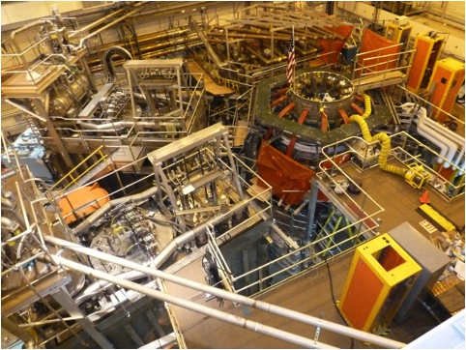
NSTXU Test Cell General Arrangement
NSTX Test Cell – 9/16/13

Slide 7
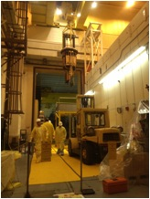
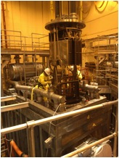
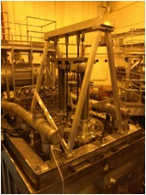
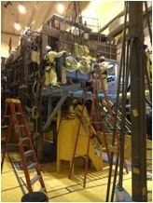
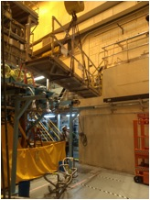
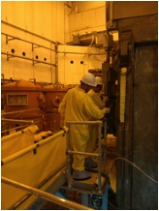
After BL & Lid, BL2 Component relocation completed
2425
Calorimeter
Ion Dump
Magnet &
Shield
LHe Dewar
90 Inch Flange
Source Platform
Shielding
Cryo Platform
Access Platforms
Pressure Plates
Decon BL and Lid
externally…

Slide 8
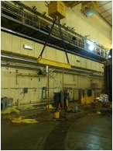
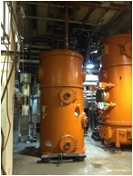
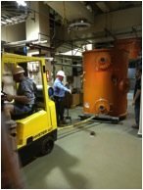
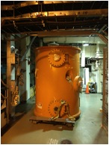
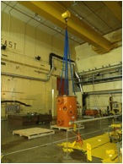
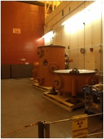
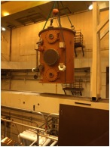
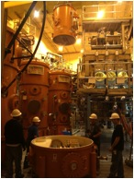
N4ABC High Voltage Enclosure relocation completed – 3 HVEs
2425

Slide 9
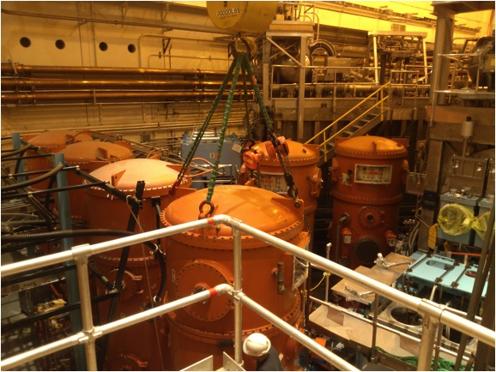
N4ABC High Voltage Enclosure relocations completed
2425

Slide 10
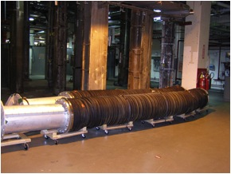
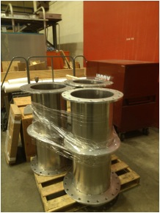
BL2 Transmission Line relocation awaits cable and tray installation
Transmission Lines in TCB awaiting completion of cable and tray installation to avoid potential damage
Transmission Line spool pieces ordered and received

Slide 11
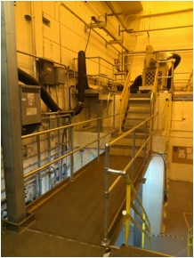
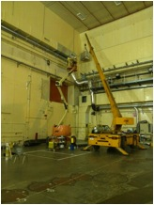
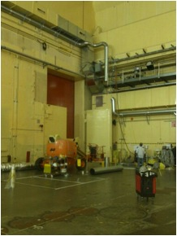
BL2 area changes required for relocation completed
NTC Access platforms modified
due to BL2 placement
After cryo line installation in TTC
HVAC and Stack Duct
moved and modified…
…and restored to service prior to
Start of Cable and Tray subcontract

Slide 12
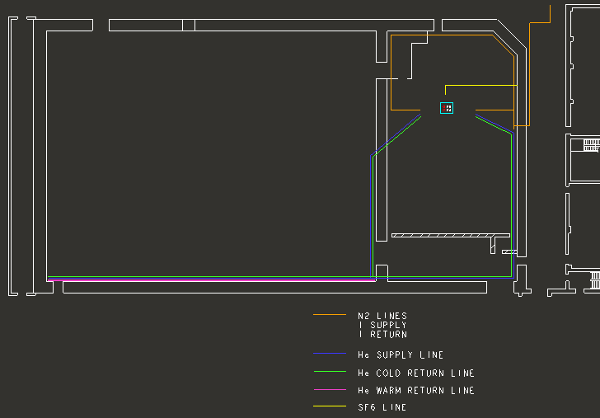
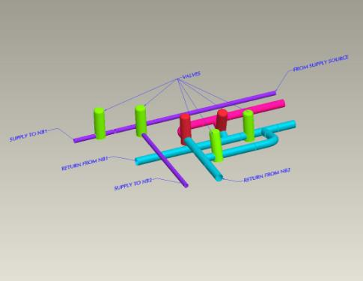
Liquid Helium & LN Cryogenic services completed.…
NTC
South Wall Cryo LHe valves
Operate either BL1 or BL2 or both…

Slide 13
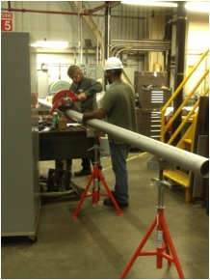
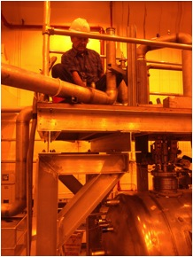
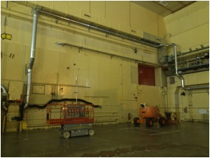
Cryogenics Line LN and LHe piping fabrication completed in NBI shop
2450
Cryo line fabrication
Cryo line installation
Cryo line installation
Cable and tray path

Slide 14
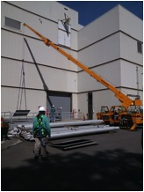
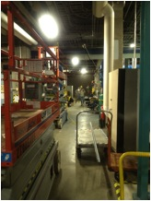
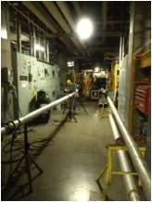
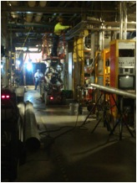
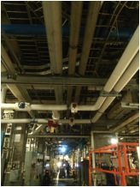
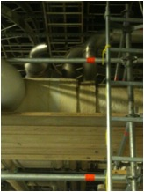
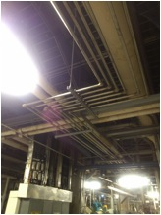
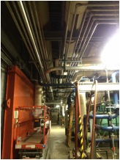
Deionized Water Piping subcontract completed (source, dump, HVE)
2450

Slide 15
NSTXU NBI Power & Controls Subcontract started
2470
2475
Accel
Decel
Fil&Arc
Mag
PLC F/O
PS F/O
NBPC Bldg
138’
TFTR TC
NSTX TC
NB Switchyard
100’
Pumproom
TFTR TC Basement
MER
Dashed lines are new cabling
15

Slide 16
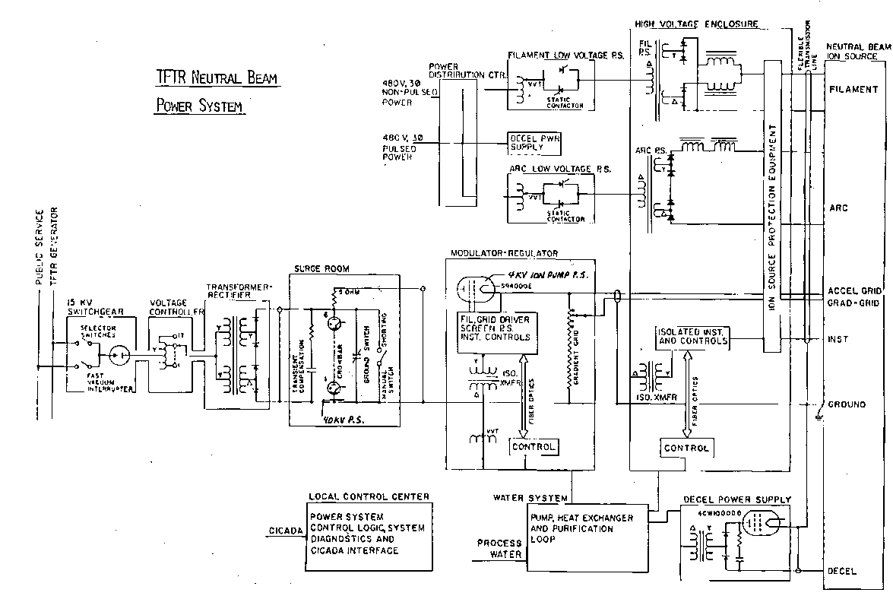
NSTXU NBI Power Supply & Controls - One Line Diagram
2470
2475
X 3
NBI NBPS One Line Diagram
16

Slide 17
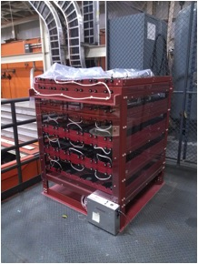
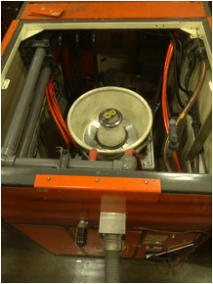
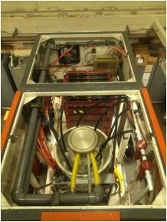
N4ABC Mod/Reg HVSTs & Gradient Grid Dividers installed
2470
X 3
Gradient Grid Divider
HVST installed in Accel Deck
… and chassis are ready to go for Accel deck electronics.
GGD and Helmet install completed

Slide 18
NSTXU NBI Controls System modifications in progress…
… but Controls Work Scope shifted out due to resource limitations.
Update NB N4ABC Power Supply controls to current status – done. Ready for testing
Mimic existing NSTX BL1 Controls scheme for BL2 but move NTC racks - done
Reactivate N4 Local Control Centers, Hardwired Interlock System – in progress*
Turn BL2 Plasma Current Interlocks on (chassis still in use for BL1) - OK
Add additional plasma interlock to prevent long pulse into armor- Ip & IpR - OK
Expand I/O for PLC control of BL and Services but use existing PLC – I/O cards loaded into racks*
Expand Thermocouple Scanning System to include BL2 & the ARMOR – Hardware here. 2 of 3 in.
Fold BL2 into EPICS & timing pages – EPICS done. Timing FDR done. Needs install and testing
Update NBOS LabView Operator interface so existing staff can run 2 BLs - software completed
No new problems - drawings completed
* Some initial progress on cable tray in gallery
Cable tray here and installation in NTC ready to resume
BL control cable here; ready to install after tray is completed
LCC modifications ready to resume after supporting Firing Generator production
18

Slide 19
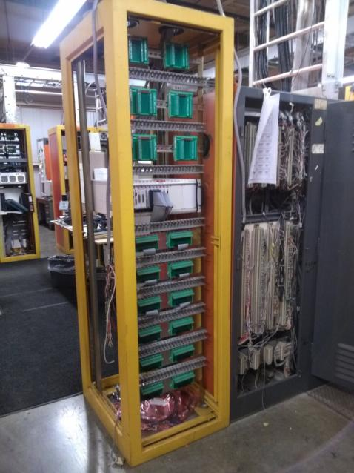
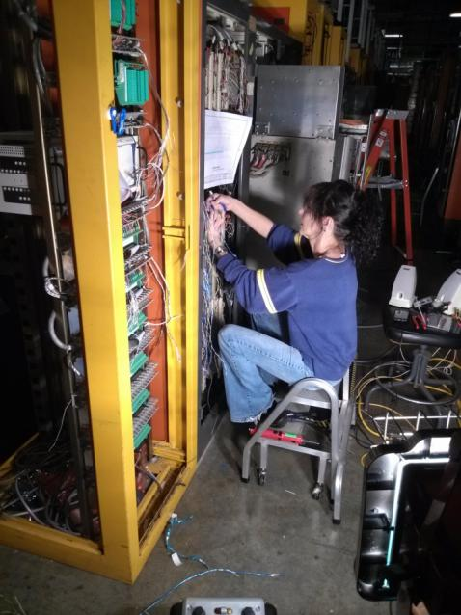
N4ABC Local Control Center upgrade and wiring in progress
2475
New NI chassis and LabView adds BL operator control purview
Software upgrades designed and coded
Additional NI and computing interfaces provide timing and data transfer with NSTX central computing and eliminates CAMAC
Wiring changes in progress…
Ready to start testing new LabView source operator controls…
X 3

Slide 20
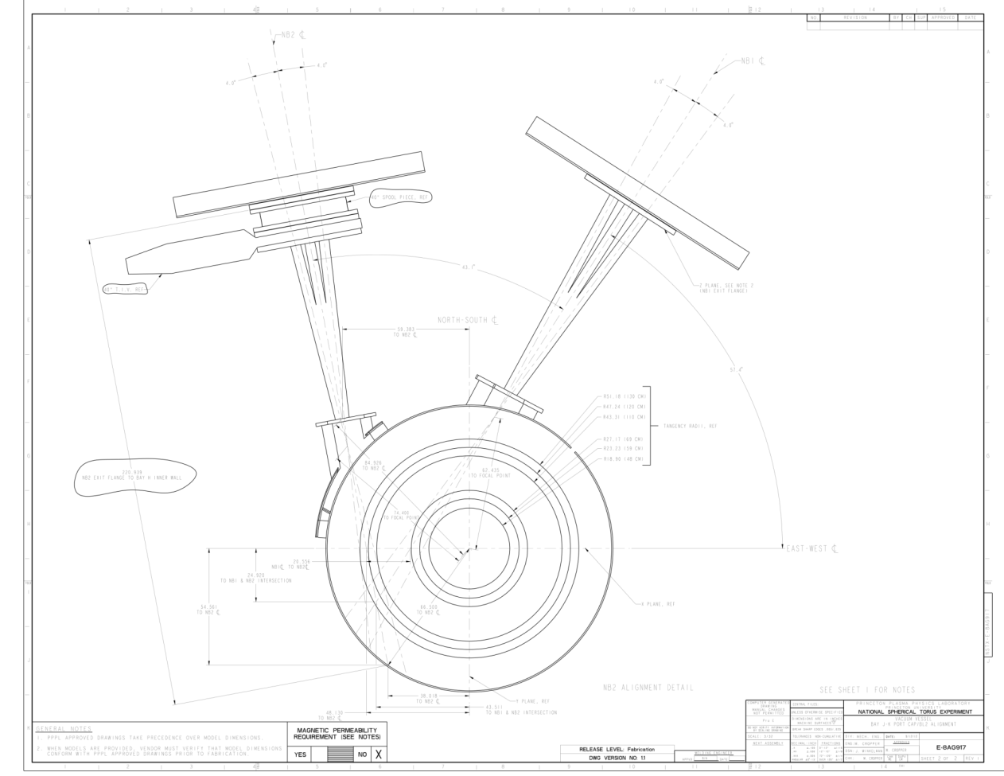
NBI BL Alignment… 110, 120, 130 cm tangency radii

Slide 21
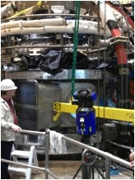
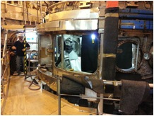
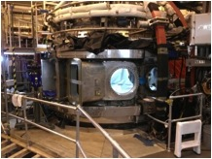
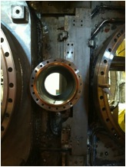
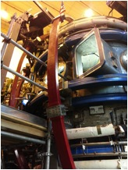
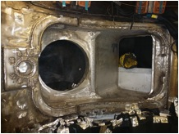
NBI Port JK Alignment and Installation completed
2480
Bay window cut
Aligned and welded into place
JK weldment installation
Old sFLIP port
Bay JK & sFLIP reinforcements
Snug fit…

Slide 22
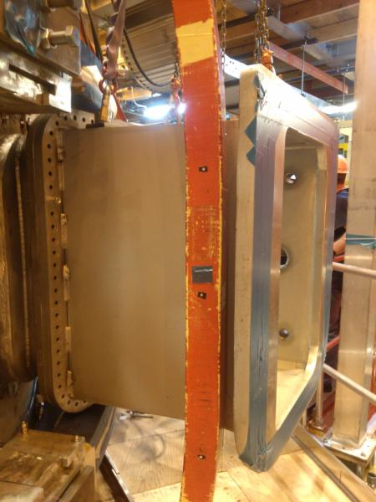


NBI Port Extension trial fit completed
2480
TF outer leg clearances maintained
Maintained ¾ inch clearance to Port Extension
for OL deflection per spec
Awaiting NBI Duct installation…

Slide 23

NBI Duct and Torus Vacuum Pumping System (TVPS)
2480
2485
40” Torus Isolation (Gate) Valve installed on BL2 and operated during alignment process
Duct leakchecking started
Moly shield installation in progress
VV leg modification required
  Engineering complete
  Field work imminent
Duct assembly and installation imminent
Vacuum system foreline, BL backing lines, and roughing line layout and drawings completed
Installation package being prepared
Fabrication and field installation planned this month
NBI and TVPS Duct hardware procurements and fabrication of hardware is complete.

Slide 24







NBI Duct & TVPS duct fabrication completed
2480
2485
… and leakchecked.
Stainless circular shields complete
Moly shields for rectangular bellows in progress

Slide 25


VV leg modification and anchoring designed, analyzed, verified
VV leg modification field work is imminent prior to duct installation
From W. Blanchard/ P. Titus

Slide 26





NBI Armor assembly and installation in progress…
2460
Supports aligned using metrology and welded in place …
Bay H Port ready for feedthroughs. Purchases completed
Bay H
Backing plates fit up in VV
Manifolds leakchecked
Carbon tiles baked out in oven
Stiffener pieces welded
Braze/weld in shop completed
Assemble/install/leakcheck in progress…

Slide 27

NBI Armor assembly and installation in progress…
2460
Painstaking trail fit made and supports aligned. Final structural welding completed.

Slide 28
NSTXU NBI: Conclusion
NBI BL2 Upgrade GRD Requirements implemented
NTC General Arrangement maintained by Construction Manager to avoid interferences
Tech Shop, Health Physics, and Work Control Center support has been excellent
BL refurbishment completed. Ready for first pumpdown and leakcheck.
Relocation to NTC – Components, Source Platform, HVE moves completed
Services fabrication and installation – Water line S/C completed. Cryogenics completed.
Power - Cable and tray S/C started. Reactivation planned FY14 Q2.
Controls progress awaits resources but is not on or near critical path
Floor space has been achieved by use of gallery and new elevated platforms
Duct fabrication is complete and leakchecked. Installation is imminent.
VV Bay JK and sFLIP modifications have been completed. VV leg mod imminent.
Armor support welding done. Armor fabrication near done. Assembly in progress.
Preoperational testing planned FY 14 Q3.
Source installation planned FY14 Q4. (July 2014)
Cost and schedule indices have tracked well to date – CPI 1.06 & SPI at 1.0
Schedule still adequate for NBI activities – not on or near critical path
NSTXU NBI project is progressing on task, under cost, on time. Heading for CD4… ☑
28

