Slide 1
Review Committee for the
National Spherical Torus
Experiment (NSTX) Upgrade Project
Princeton Plasma Physics Laboratory
October 2-3, 2013
Stephen W. Meador, Chairperson
DOE/SC Review Committee
Office of Science, U.S. Department of Energy
http://www.science.doe.gov/opa/

Slide 2
DOE Review of NSTX
DOE EXECUTIVE SESSION AGENDA
Wednesday, October 2, 2013— LSB, Room B318
8:00 a.m. Introduction and Overview S. Meador
8:15 a.m. FES Perspective B. Sullivan
8:30 a.m. Federal Project Director Perspective T. Indelicato
8:45 a.m. Adjourn
Project and review information is available at:
http://evms.pppl.gov/Lehman_131002/index.html

Slide 3
Review Committee
Stephen Meador, DOE/SC, Chairperson
Review Committee
SC 1–Technical Approach
*Arnie Kellman, General Atomics
Will Oren, TJNAF
SC 2–Cost and Schedule
*Kin Chao, DOE/SC
Tim Maier, DOE/BHSO
SC 3–Management and ES&H
*Frank Crescenzo, DOE/BHSO
Mike Epps, DOE/TJSO
Robin Noyes, DOE/APM
*Lead
Observers
Ed Synakowski, DOE/SC
Joe May, DOE/SC
Barry Sullivan, DOE/SC
Tony Indelicato, DOE/PSO
Maria Dikeakos, DOE/PSO

Slide 4
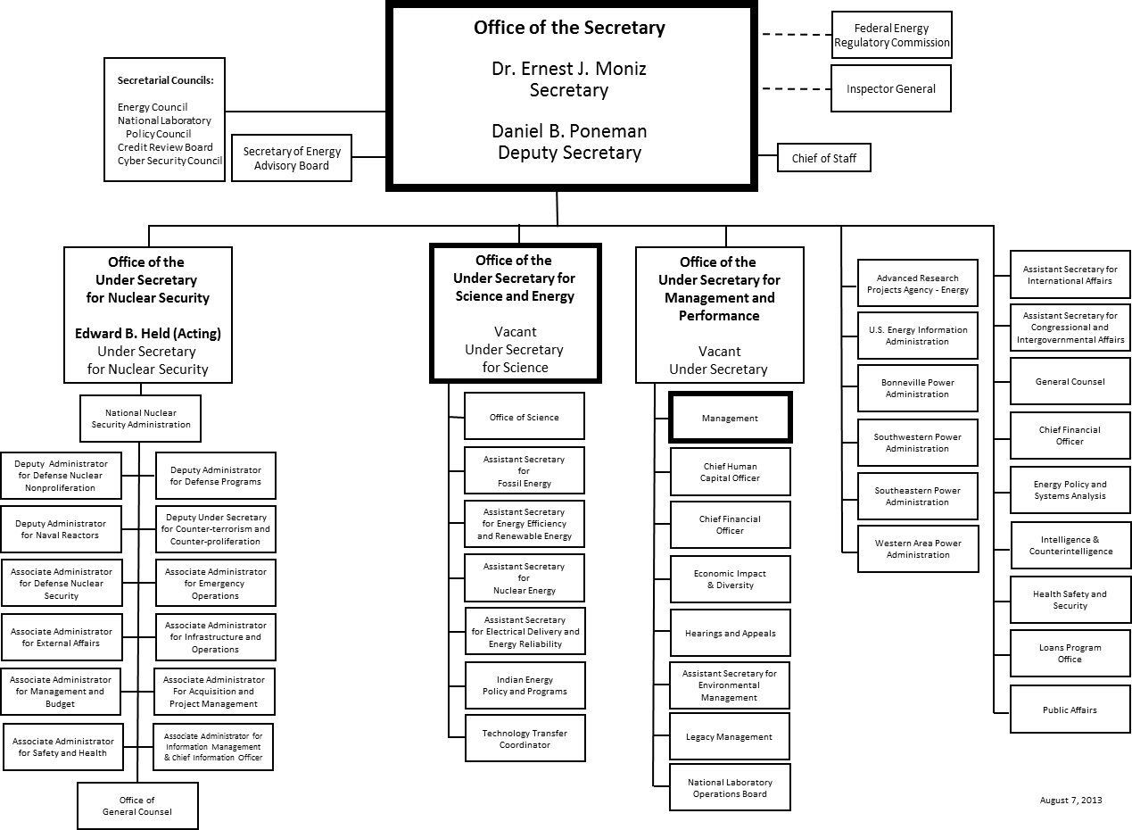
Department of Energy

Slide 5
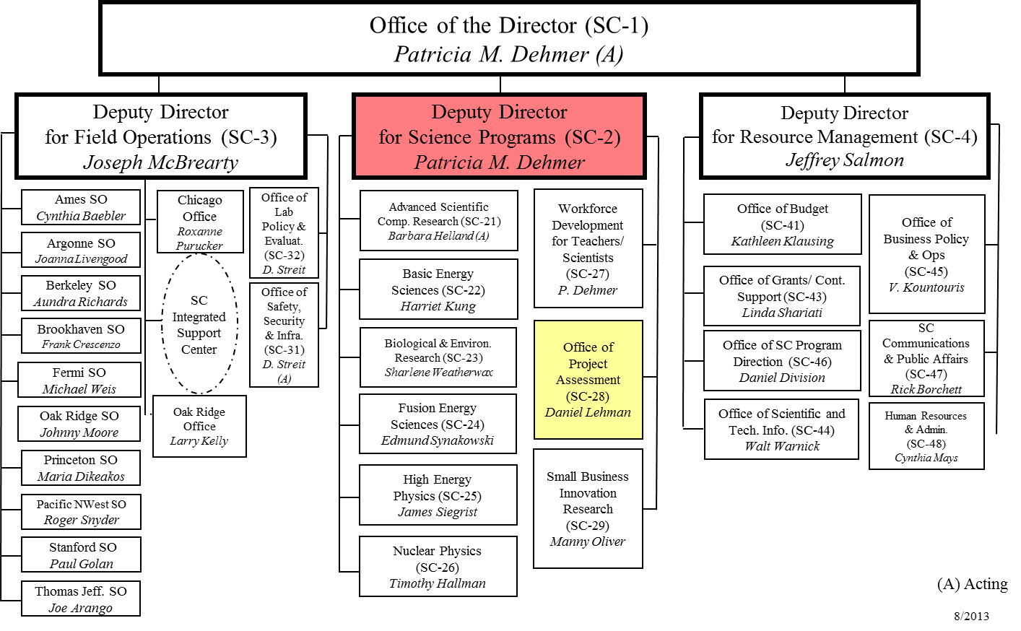
Office of Science

Slide 6
Charge Questions
Construction Efforts: Are construction efforts being executed safely? Does the project have adequate resources and the appropriate skills mix to execute the project per the plan?
Baseline Cost and Schedule: Are the current project cost and schedule projections consistent with the approved baseline cost and schedule? Is the contingency remaining adequate for the risks that remain?
Management: Evaluate the management structure as to its adequacy to deliver the scope within budget and schedule. Are risks being actively managed? Has the project responded satisfactorily to the recommendations from the previous project reviews?
Transition to Operations: Is the Project appropriately aligned for completion of construction efforts and transitioning to NSTX-U for CD-4 approval?

Slide 7
Agenda

Slide 8
Agenda Cont’d

Slide 9
Report Outline/ Writing Assignments

Slide 10
Closeout Presentation and Final Report Procedures

Slide 11
Format: Closeout Presentation
(No Smaller than 18 pt Font)
2.1 Use Section Number/Title corresponding to writing assignment list.
List Review Subcommittee Members
List Assigned Charge Questions and Review Committee Answers
2.1.1 Findings
In bullet form, include an assessment of technical, cost, schedule, and management.
2.1.2 Comments
In bullet form, list descriptive material assessing the findings and the conclusions based on the findings. This is narrative material and is often omitted as a separate heading and the narrative included either under Findings or Recommendations as appropriate. This heading carries more emphasis than the Findings, but does not require an action as do the Recommendations. Do not number your comments.
2.1.3 Recommendations
Begin with action verb and identify a due date.
2.

Slide 12
Format: Final Report
(MSWord; 12 pt Font)
2.1 Use Section Number/Title corresponding to writing assignment list.
2.1.1 Findings
Include an assessment of technical, cost, schedule, and management. Within the text of the Findings Section, include the answers to the review questions.
2.1.2 Comments
Descriptive material assessing the findings and the conclusions based on the findings. This is narrative material and is often omitted as a separate heading and the narrative included either under Findings or Recommendations as appropriate. This heading carries more emphasis than the Findings, but does not require an action as do the Recommendations. Do not number your comments.
2.1.3 Recommendations
Begin with action verb and identify a due date.
2.
3.

Slide 13
Expectations
Present closeout reports in PowerPoint.
Forward your sections for each review report (in MSWord format) to Casey Clark, casey.clark@science.doe.gov,
by October 7, 8:00 a.m. (EDT).

Slide 14
Closeout Report by the
Review Committee for the
National Spherical Torus
Experiment (NSTX) Upgrade Project
Princeton Plasma Physics Laboratory
October 3, 2013
Stephen W. Meador
Review Committee Chair
Office of Science, U.S. Department of Energy
http://www.science.doe.gov/opa/

Slide 15
2. Technical Status A. Kellman, GA*/SC-1
Findings
Comments
Recommendations
Construction Efforts: Are construction efforts being executed safely? Does the project have adequate resources and the appropriate skills mix to execute the project per the plan?
Transition to Operations: Is the Project appropriately aligned for completion of construction efforts and transitioning to NSTX-U for CD-4 approval?

Slide 16
3. Cost and Schedule K. Chao, DOE/SC*/ SC-2
Baseline Cost and Schedule: Are the current project cost and schedule projections consistent with the approved baseline cost and schedule? Is the contingency remaining adequate for the risks that remain?
Transition to Operations: Is the Project appropriately aligned for completion of construction efforts and transitioning to NSTX-U for CD-4 approval
Findings
Comments
Recommendations

Slide 17
Project Status K. Chao, DOE/SC*/ SC-2
PROJECT STATUS
Project Type | MIE / Line Item / Cooperative Agreement
CD-1 | Planned: | Actual:
CD-2 | Planned: | Actual:
CD-3 | Planned: | Actual:
CD-4 | Planned: | Actual:
TPC Percent Complete | Planned: _____% | Actual: _____%
TPC Cost to Date
TPC Committed to Date
TPC
TEC
Contingency Cost (w/Mgmt Reserve) | $ | _____% to go
Contingency Schedule on CD-4b | ______months | _____%
CPI Cumulative
SPI Cumulative

Slide 18
4. Management and ES&H F. Crescenzo, BNL*/SC-3
Construction Efforts: Are construction efforts being executed safely? Does the project have adequate resources and the appropriate skills mix to execute the project per the plan?
Management: Evaluate the management structure as to its adequacy to deliver the scope within budget and schedule. Are risks being actively managed? Has the project responded satisfactorily to the recommendations from the previous project reviews?
Transition to Operations: Is the Project appropriately aligned for completion of construction efforts and transitioning to NSTX-U for CD-4 approval?
Findings
Comments
Recommendations

